Slide 1
Theme 17 - Social Media & Fakes News
Guidance Plan:
The emergence of Social Media has radically changed the information creation and consumption process and shifted the route of communication from ‘one to many’ channel, to being a ‘many to many’ channel. This has offered new opportunities and challenges to ECI's Mandate of conducting free, fair and transparent elections.
This PPT has a 2-fold objective of informing and equipping the RO with strategies and mechanisms devised by ECI to respond in real time to the challenges of fake news, misinformation/disinformation and, to expose the ROs to the digital engagement initiatives of ECI in enhancing voter awareness and participation.
The PPT opens with the evolution of the Social Media Guidelines culminating in the Voluntary Code of Ethics, its salient features along with its legal provisions, particularly regarding Hate Speech. The subsequent slides are devoted to Fake News/Disinformation/Misinformation and the ‘FACT Principle’ strategy adopted by ECI to tackle them, accompanied by relevant Case Studies.
The focus then on shifts to the monitoring, reporting & grievance redressal mechanisms. The RO is apprised of the role of the Social Media Expert in MCMC. The Reporting Channels for social media for violations is elucidated thereupon along with the actions undertaken at each stage. Subsequently the PPT briefs the RO of the grievance redressal channel and procedure and the role of the Nodal Officers for the same.
In the section on ECI’s presence on Social Media, the RO is made aware of the various platform account details and the roles and responsibilities of the CEO, DEO, Social Media Nodal Officer, etc. who have been charged with different platform operations. Particular emphasis is given on the SoP for pre-poll and Polling Day Social Media updates.
The PPT then dwells into the digital engagement aspects aimed at enhancing voter awareness & education and voter participation. ECI campaigns and creatives developed have been presented for guidance of the RO.
The concluding segment of the PPT is a retrospective for the RO on the Social Media initiatives and activities undertaken during the General Elections 2019.

Slide 2
Part – A
ECI's Mandate and Social Media Guidelines

Slide 3
ECI's Mandate
Article 324 of the Constitution of India
Superintendence, control and direction of elections to the offices of the President, the Vice-President and to both Houses of Parliament and State Legislatures in India.
Ensuring Free, Fair, Transparent, Ethical, Accessible & Inclusive Elections

Slide 4
Social Media Guidelines
Measures to prevent misuse of social media for conducting free and fair Elections and ensure level playing field for all stakeholders -
ECI’s social media specific guidelines for candidates & election campaigning
Voluntary Code of Ethics
Fake News and Misinformation Campaigns
Contd…

Slide 5


Social Media Guidelines – Timeline – contd.
ECI’s first set of instructions with respect to use of social media in Election Campaigning
October 2013
Consultation with stakeholders for developing a road map on the use of social media December 2015
Commencement of Voluntary Code of Ethics during elections March 2019
Instructions on application of pre-certification on political advertisements appearing in e-papers
August 2014
Inclusion of a Social Media Expert in the Media Certification and Monitoring Committees
February 2019
Setting up of a Permanent Media Cell and a Social Media Cell
June 2023

Slide 6
Usage of Social Media during elections - candidates and election campaigning
All contesting candidates must furnish details of their authentic social media accounts at the time of filing nominations.
Social Media by definition falls under the category electronic media. Therefore, all political advertisements on social media require proper pre-certification from the Media Certification and Monitoring Committee (MCMC) before being posted on social media.
All candidates need to incorporate expenditure of social media campaigning including expenditure on political advertisements, cost of maintaining the accounts, developing content and salaries of the employees who manage the accounts in the election expenditure account of the candidate.

Slide 7
Usage of Social Media during elections - candidates and election campaigning – contd.
Model Code of Conduct (MCC) for political parties and candidates shall be applicable on the content posted on the internet, including social media websites by candidates and political parties.
Any political content in the form of messages/comments/photos/videos uploaded on ‘blogs/self accounts’/websites/social media platforms will not be treated as political advertisement. Even if the same is posted/uploaded by political parties/candidates, it would not be treated as political advertisement.

Slide 8
Part – B
Voluntary Code of Ethics (VCE) and Legal Provisions

Slide 9
Voluntary Code of Ethics - Genesis
In March 2019, major social media platforms under the aegis of Internet & Mobile Association of India (IAMAI) devised a VCE and committed to adhere with the same during elections for maintaining spirit of free and fair elections.
The 'Voluntary Code of Ethics' came into effect on March 20, 2019 and is now applicable during all General and State Assembly Elections .
Major Social Media Platforms (SMP) - Twitter, Google & its products, Facebook, Whats App, Share Chat, Koo are signatories of VCE
Contd…

Slide 10
Voluntary Code of Ethics – Salient features – contd.
Social Media platforms will voluntarily undertake information, education and communication campaigns to build awareness including electoral laws and other related instructions.
Social Media platforms have created a high priority dedicated grievance redressal channel for taking expeditious action on the cases reported by the ECI.
Social Media Platforms and ECI have developed a notification mechanism - thus ECI can notify the relevant platforms of potential violations of S 126 RPA 1951 and other electoral laws.
Platforms will ensure that all political advertisements on their platforms are pre-certified from the Media Certification and Monitoring Committees as per the directions of Hon’ble Supreme Court.
Participating platforms are committed to facilitate transparency in paid political advertisements, including utilising their pre-existing labels/disclosure technology for such advertisements.

Slide 11
Hate Speech - Legal Provisions
The term “Hate Speech” has not been defined under any existing Law in India. However, some sections of IPC/RP Act can be seen in this context.
S 295A of the IPC defines and prescribes a punishment for deliberate and malicious acts, intended to outrage religious feelings of any class by insulting its religion or religious beliefs.
S 153A IPC - Promoting enmity between different groups on ground of religion, race, place of birth, residence, language, etc., and doing acts prejudicial to maintenance of harmony.
Contd…

Slide 12
Hate Speech - Legal Provisions – contd.
S 298 IPC - Uttering words, etc., with deliberate intent to wound the religious feelings.
S 505 IPC - Statements conducing to public mischief – intention to cause fear/alarm in public
S 125 RPA, 1951 provides that any person, who in connection with an election under this Act, promotes or attempts to promote feelings of enmity or hatred, between different classes of the citizens of India shall be punishable with imprisonment for a term which may extend to three years, or with fine, or with both.
In the Model Code of Conduct, it is stated under “General Conduct” that “no party or candidate shall include in any activity which may aggravate existing differences or create mutual hatred or cause tension between different castes and communities, religious or linguistic” and that “there shall be no appeal to caste or communal feelings for securing votes. Mosques, Churches, Temples or other places of worship shall not be used as forum for election propaganda.”
S 66A of the Information Technology Act, that punishes sending offensive messages through communication services is added when such speech is made online.

Slide 13
Part – C
Fake News/Misinformation – Monitoring and Response

Slide 14
Fake News/Misinformation on Social Media
Malicious and Fake News Campaigns in the age of social media have become an ever alarming challenge/menace in conducting free - fair and peaceful elections.
Fake News when tactfully spread, can hugely manipulate the opinions of the electors and alter electoral verdicts.
It becomes an alarming issue when such viral news items are then picked by news organizations and treated as authentic news items.
Hence it is imperative to check the malicious act and counter the spread of such misinformation.
Timely identification & response helps limit the damage done by such malicious campaigns.

Slide 15
Countering Fake News/Disinformation/Misinformation
Interim response/ rapid response checks -
a. Can be -
Technologically aided – social listening tools
Restrictive approach (can help prevent disinformation (malicious intent) curbs problematic content; regulatory
b. As also -
Proactive Communication (can help prevent misinformation (inadvertent error)
Voter Education; Disinformation Webpage
Informative approach - increase timely dissemination of credible information

Slide 16
Social Media strategy - FACT principle
F - Find, Flag, Track on real time basis
A - Analyze and decide next step of action
C - Create content...tailoring as per requirement
T - target dissemination of factually correct information depending on instance at DEO/CEO/ECI level

Slide 17
Social Media strategy - Steps to be ensured
Flagging concerned post, emerging trend of news reports
Ascertaining facts ASAP (depending on situation – could be from hour to days) – whether from ECI Section or CEOs’ teams
Interim response as per situation - from CEO/ECI platforms
Deciding on scale and content of response
Deciding modes of dissemination –
  press releases,
  briefings,
  website,
  SM platforms,
  using CEO, PIB regional
  network to amplify as per requirement deciphered

Slide 18
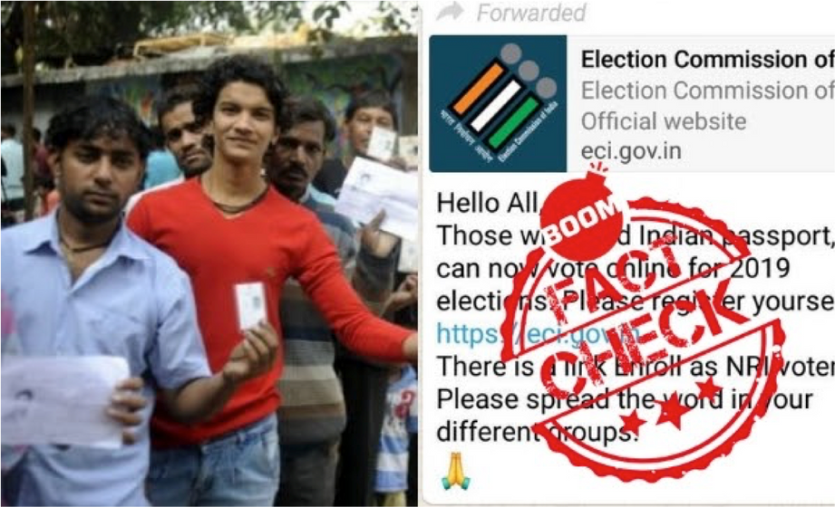
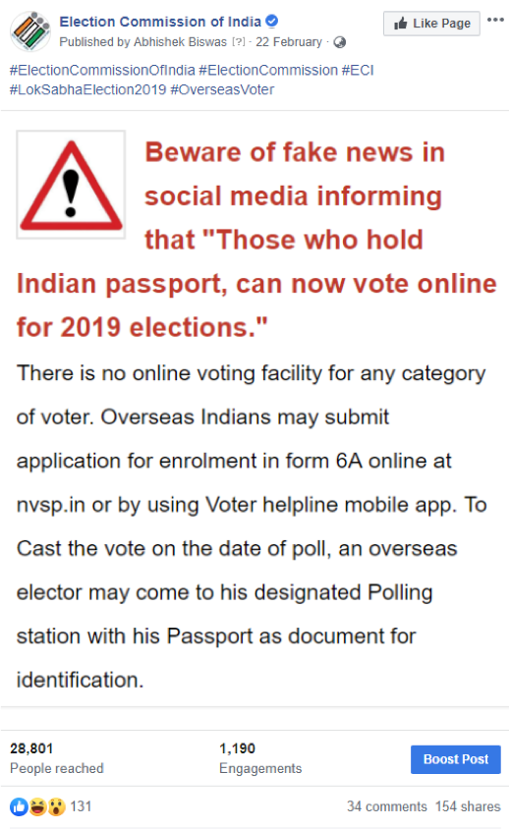
Countering Fake News – Case Study
Fake news -
Action by ECI -
Fake News about online voting by NRI voters was spread during 2019 Lok Sabha Election which was countered by ECI through proactive dissemination of factual details.
Contd…

Slide 19
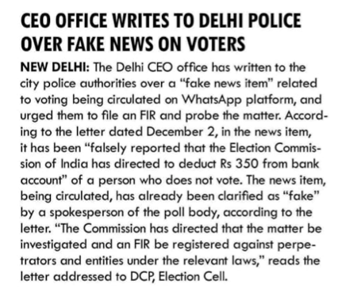
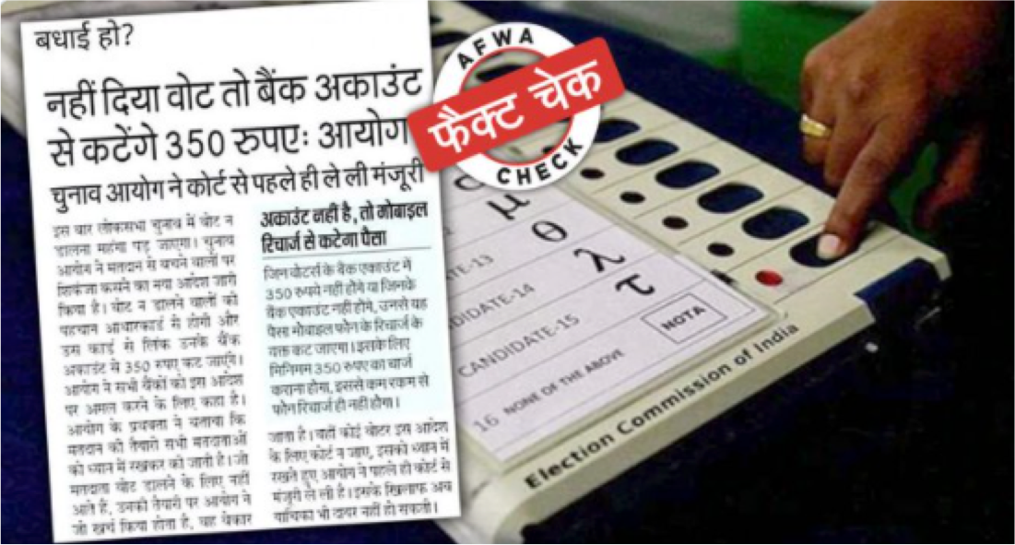
Countering Fake News – Case Study – contd.
Action by ECI -
Fake news -
ECI through its twitter handle busted this misinformation as a satirical piece which was cropped and circulated on social media with malicious intent.
An FIR has been lodged against the people circulating the misinformation with malicious intent for penal action against the culprits.
A satirical piece of an old newspaper clipping was noticed to be circulating on social media about compulsory voting in elections. A newspaper clipping alleged that if a person fails to vote in the elections, an amount of 350 rupees would be deducted from their accounts.

Slide 20
Efforts by EMBs of other countries to counter Fake News
Australian EMB
German EMB
Brazilian EMB
The Australian Electoral Commission (AEC) established a Disinformation Register to combat the spread of fake news listing the prominent pieces of disinformation targeting the federal electoral process, correct information and action taken by AEC.
https://www.aec.gov.au/media/disinformation-register.htm
German EMB the Bundeswahlleiter -Established a 'Facts Against Fake News' webpage which, serving as an official, neutral and reputable source of information regarding the election process, established facts against fake news, and correcting any wrong, false or misleading statements.
https://www.bundeswahlleiter.de/en/bundestagswahlen/2021/fakten-fakenews.html
In 2019, Brazil's EMB- the TSE launched its "Combatting Disinformation Program" which focused on combating false information targeting the 2020 general elections. It brought together approximately 60 organizations including fact- checking organizations, political parties, education and research institutions and social media platforms

Slide 21
Part – D
Social Media – Monitoring, reporting & grievance redressal Mechanisms

Slide 22
Media Certification & Monitoring Committee (MCMC)
All political advertisements appearing in the electronic media including Social Media are to be pre- certified by MCMC at State/District level
Functions of MCMC
Certification of Political Advertisements on Electronic Media
Examining complaints/issues of Paid News
Scan all media to assist in enforcement of media related regulations in law.

Slide 23
Social Media Expert in MCMC
Reconstitution of MCMC:
Keeping in view of the growing prominence, crucial role and impact of Social Media, ECI on 25 Feb 2019, reconstituted MCMC by way of inclusion of an intermediary/Social Media expert as a member in State/District Level MCMC
Role of Social Media Expert in MCMC:
Assist MCMC in –
  certification of political advertisements for social media platforms and ensuring that the Election Laws are strictly adhered to with matters related to advertisements on social media platforms.
  Scanning social media platforms for suspected cases of Paid News.
  submitting a daily report to the accounting team w.r.t. expenditure incurred by the candidate on election advertising on social media platforms.
  matters of queries/complaints related to media platforms.
  handling the violation cases on Social media.
NB: Being part of State level MCMC, Social Media Expert assists in deciding on appeals from District and Addl. /Jt. CEO Committee on certification of advt. on social media and also examining all cases of Paid News on appeal against the decision of District MCMC or cases that they may take up suo-motu.

Slide 24
Social Media - Monitoring & reporting mechanisms
Reporting channels:
District/State level MCMCs to monitor social media for violations
District level MCMCs to report social media violations to State CEO office
Social media nodal officer in CEO office to report violations to ECI Social Media Nodal Officers.
ECI Social media Nodal Officers to report the violations to social media platforms for take down and necessary action.
NB: In case any violations of MCC or any other Commission’s instructions/provisions of the law and court’s orders in the matters related to election, the same shall be forwarded/reported by CEO office to Nodal Officers appointed by the Commission and not directly to any of the Social Media Platforms.
Contd…

Slide 25
Social Media - Monitoring & reporting mechanisms – graphic – contd.
District/State level MCMCs to monitor social media for violations
Social Media Nodal Officer in the District to report violations to Social Media Nodal Officer in CEO office
Social media nodal officer in CEO office to report violations to ECI Social Media Nodal Officers.
ECI Social media Nodal Officers to report the violations to social media platforms for take down and necessary action
NB: In case any violations of MCC or any other Commission’s instructions/provisions of the law and court’s orders in the matters related to election, the same shall be forwarded/reported by CEO office to Nodal Officers appointed by the Commission and not directly to any of the Social Media Platforms.

Slide 26
Social Media - Grievance redressal
Vide Voluntary Code of Ethics (VCE), timebound grievance redressal channel & procedure through designated nodal officers should be followed.
No hasty partisan decisions should be taken/ or put in public domain without due deliberation
Take down requests should clearly spell out nature/specific clause violated
Regional language clips should reach with clear transcript , translated in English; specific links shared so as to not lose time and be able to ‘kill’ objectionable material on SMPs ASAP within timelines agreed to vide VCE

Slide 27
Part – E
ECI’s presence on Social Media

Slide 28
ECI’s presence on Social Media
Engagement on social media is a very essential aspect of the 360 degree strategy for voter awareness as part of ECI SVEEP programme.
ECI Social media strategy rooted in the pillars of Information, Motivation and Engagement.
Using creative posts, engaging audio- video content, online contests, content crowdsourcing, partnership with ECI icons on social media for awareness and information dissemination.
Regular alerts to media through social media platforms
Contd…

Slide 29
ECI’s presence on Social Media – objectives – contd.
Focus on Voter Awareness
Increasing Voter Registration
Curbing Voter Apathy
Increase Voter Turnout
Encouraging Informed & Ethical Voting
Communicating Data with interesting graphics
Sharing Unique Interesting Stories & Archival photos/videos
Curbing Fake News & Sharing facts & authentic information
Redressing Queries
Contd…

Slide 30
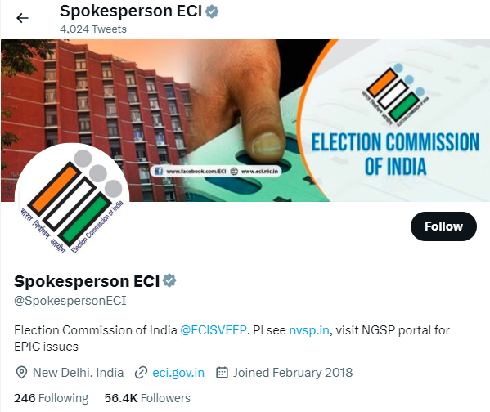
ECI presence on Social Media – Platform details – contd.
@SpokespersonECI account
This account shares Press Releases and Important Updates from the Election Commission of India
Contd…

Slide 31
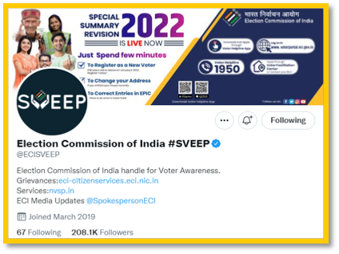
ECI presence on Social Media – Platform details – contd.
@ECISVEEP official verified accounts on Facebook, Twitter, Instagram & YouTube.
Chief Electoral Officers of all 36 States/UTs also have presence on these 4 social media platforms.
District Election Offices in each state share on ground updates of voter outreach activities from the ground
Social Media cell with Social Media Nodal Officer appointed in all CEO offices

Slide 32
SOP for Pre-Poll for Social Media updates
Information, photos and short videos to be put out about the preparations:
Information regarding magnitude of activity (like number of polling booths, electorates, ACs etc. should be put out from DEO and CEO handles mentioning district and state level data.
Dispatch of polling parties along with election material
Dispatch of material to various locations including difficult terrain and geographically remote locations, unique polling stations set up, etc.
Dispatch of COVID kits like sanitizer, face masks, hand gloves, COVID protocols like sanitization of polling stations
Meetings by DEOs/ CEOs if any
Other relevant information
NB 1: The efforts should be made to showcase the cultural diversity, uniqueness of the activity, different gender, linguistic, cultural groups etc.
NB 2: The above activity should start at 8 AM.

Slide 33
SOP for Polling Day for Social Media updates
Information, photos and short videos to be put out on various social media platforms of DEOs/ CEO:
As a standard protocol, photos/ information regarding peaceful voting in various polling booths:
Photos on PwD and elderly persons being assisted by ECI officials, participation of different categories of voters including Women, first time voters, centenarian voters, Third gender voters , etc.
Assured Minimum Facilities at PS, Facilities like Pick & Drop facility, Wheelchairs at PS, etc.
Special Polling Stations - Model polling stations, all women booths, PwD managed polling stations, Youth managed polling stations
Information photos on arrangements for COVID Appropriate Behavior like maintaining Social Distancing, hand sanitizers at polling booths(arrangements as per instructions, if any)
Any other unique photos/information/videos etc.
NB 1: The above activity should start at 7 AM -7.30 AM.
NB 2: The updates should be shared at regular intervals, every two hours, to the local/ regional media along with social media updates.

Slide 34
Part – F
Engaging with voters digitally

Slide 35
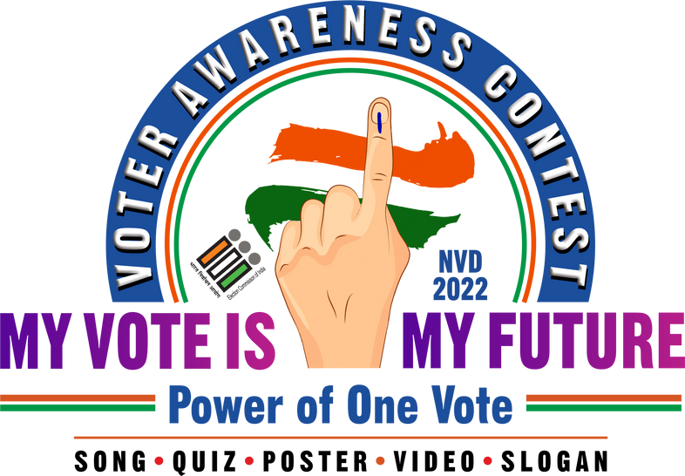
National Voter Awareness Contest
Enhancing engagement & Crowdsourcing ideas- Creativity & talent of citizens
National Voter Awareness Contest - ‘My Vote is my Future- Power of One Vote’ – Launched on the occasion of NVD 2022 i.e. Jan 25, 2022
Five categories to engage and tap the talent & creativity of citizens – Quiz, Song, Video, Slogan and poster contests
Contest classified into three categories of participants – Amateur, Professional & Institutional
Exciting Cash Prizes and rewards for the winners. (more details at https://ecisveep.nic.in/contest/)

Slide 36
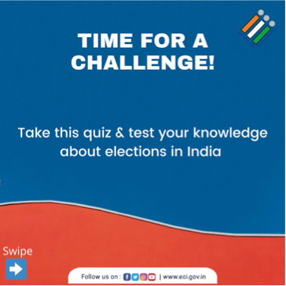
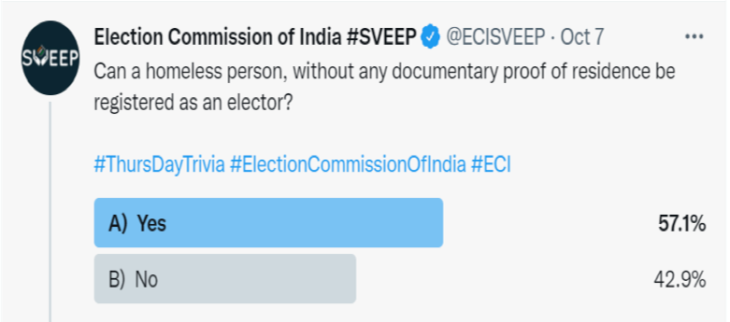
Voter Quotient Quiz on Social Media
Contd…

Slide 37
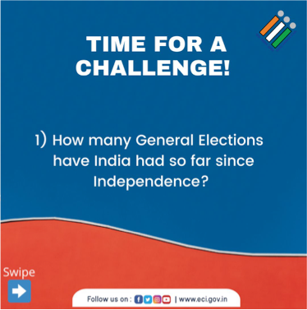
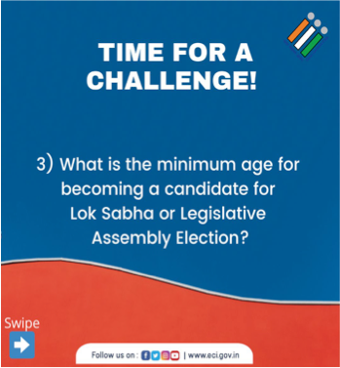
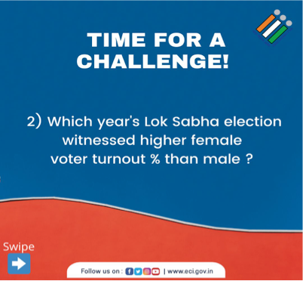
Voter Quotient Quiz on Social Media – contd.
Contd…

Slide 38
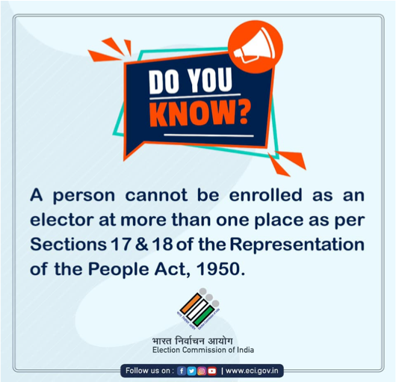

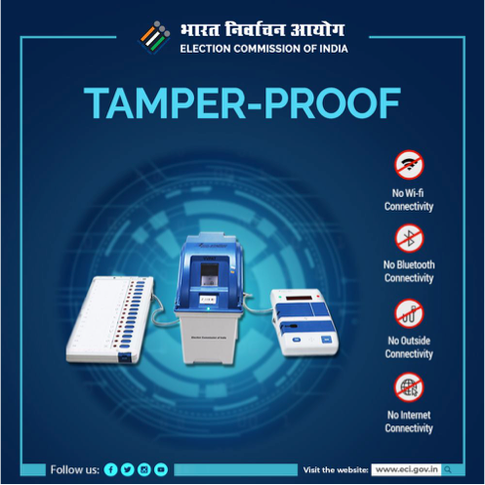
Voter awareness activities - examples & creatives
Contd…

Slide 39
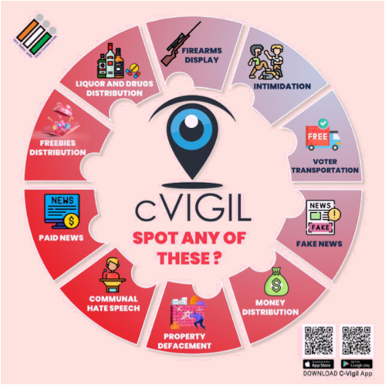
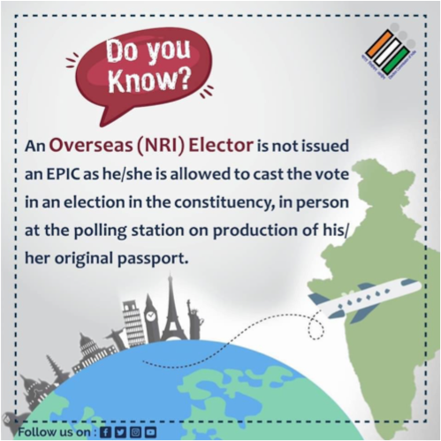
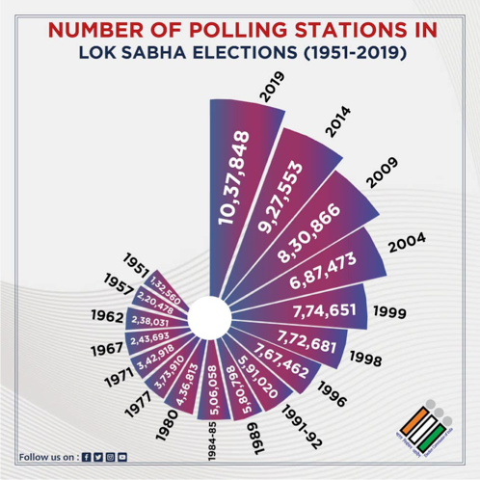
Voter awareness activities - examples & creatives – contd.

Slide 40
Part – G
General Elections 2019- Social Media

Slide 41

General Elections 2019- Social Media
Different social media platforms took various initiatives for voter awareness and education
Google during 2019 LS designed a Google Doodle with an inked finger. Moreover, all questions related to elections on Google were redirected to the ECI website, which then provided verified answers to these queries. This helped clear many doubts and provided voters with easy access to information.
YouTube creators created short interesting videos on voter awareness and also informed and ethical voting processes that were featured on the ECI channel.
Contd…

Slide 42
General Elections 2019- Social Media – contd.
The 2019 LS election saw the widespread and innovative use of digital media and technology. Various stakeholders including ECI, political parties and candidates used digital media extensively for campaigning, education, awareness and voter mobilisation.
This extensive use of digital media was due to nearly half of India’s 900 million eligible voters having access to the Internet and social media.
Keeping this in mind and to reach out to the young populace on new age social media platforms, ECI launched its official Twitter and Instagram handles. Prior to GE 2019, ECI had an official YouTube channel and Facebook page that contained all the videos, films and content produced nationally as well as regionally.
Contd…

Slide 43
General Elections 2019- Social Media – contd.
Posts were planned in a structured manner with two states selected each day for posting motivational videos, graphics & pictures along with date of polls.
Posts with caricature of icons were the most popular and evoked maximum response.
‘Shout Out’ on poll day included different campaigns such as selfie with inked finger #GotInked and placards/slogans on elections.
The Quiz #VoterQuotient on Twitter witnessed remarkable response and all winners were sent prizes & ECI merchandise with messages on elections.
All State CEO social media handles were in sync with the ECIs handle. Apart from sharing information from the official handle and they were also recreating and sharing in their regional language to spread awareness
Contd…

Slide 44

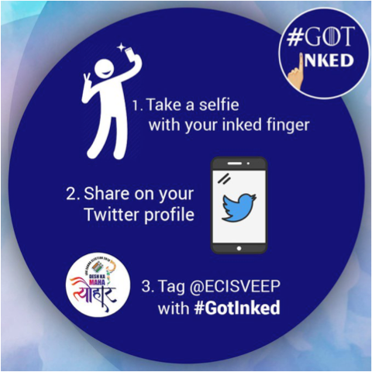
General Elections 2019 - Social Media – #GOTINKED Campaign contd.
The styled O in "GOT Inked", a social media campaign asking for selfies of inked fingers, was a shout-out to the wildly popular HBO series.
Contd…

Slide 45

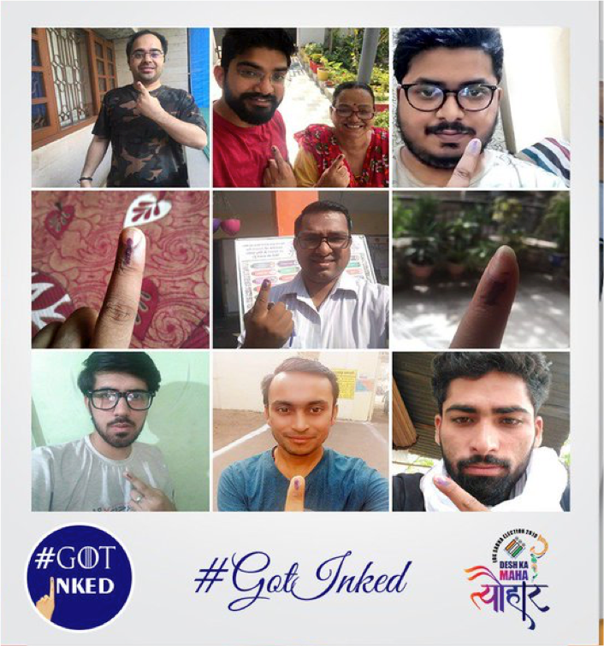
General Elections 2019 - Social Media – #GOTINKED Campaign contd.
Contd…

Slide 46
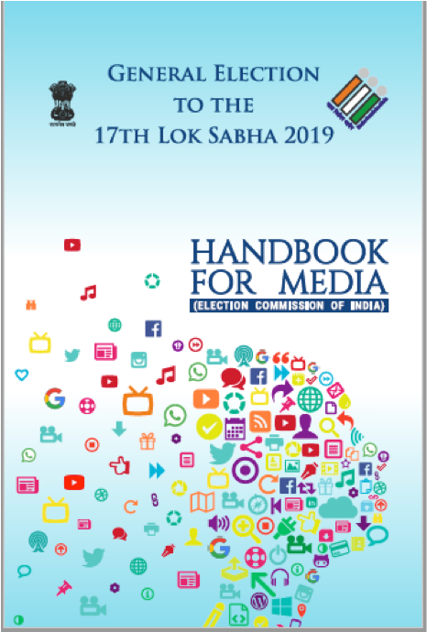

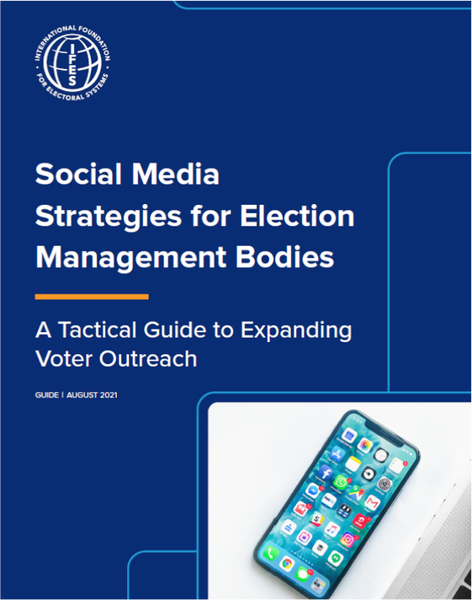
Reference Materials
https://eci.gov.in/files/file/9785-handbook-for-media/
https://eci.gov.in/files/file/5677- social-media-document/
https://www.ifes.org/publicatio ns/social-media-strategies- election-management-bodies

