Slide 1
Theme 15 - Election Expenditure Monitoring
Guidance Plan:
The mandate of A324 i.e., to conduct free and fair elections are underwritten by a framework of Election expenditure Management, result of statuary framework, decisions of the Apex Court and ECI’s own instructions.
Through this PPT it is expected that a clear understanding of what constitutes permissible expenditures; impermissible expenditures; illegal election expenditures. The concept of upper expenditure limit notified by the Commission for the AC and the PC and the formats and mechanisms to account for the said limit. Thereafter, the types of defaults that may occur on behalf of the candidate and/or the party is to be understood. The consequence of default which may overlap as a basis for an EP or/and for coercive action under 10A RPA 1951, ‘Electoral offences’ and/or ‘IPC offences’.
An extensive EEM Monitoring and enforcement administrative structure which mandatorily comes into being for each election including bye-elections is then explained. It is expected that there will be a good understanding as to how various aspects of both permissible and legal expenditure is monitored and accounted and the typical impermissible and illegal expenditures are to be detected. This capacity of the EEM machinery to correctly to do the detection and accounting of both legal and illegal election expenditure is what ensures a level playing field. It ensures consequence of default, thereby resisting the influence of money power in elections.
The PPT will also situate the vertical of EEM monitoring directly by the RO/CEO and the unique interaction of the electoral machinery with other central and state agencies such as the banks, railways, civil aviation, road transport, state excise, forest, commercial taxes and central enforcement agencies such as IT, ED, CBI, NCRB, central law enforcement verticals such as CISF, RPF, etc.
It is expected that a sequential understanding of the action points required to be monitored w.e.f announcement of the elections (PN and notification), campaign period and account filing period post-elections and the related statutory formats of reporting – is achieved.

Slide 2
Contents
A
Impact of money power
Rescinding of election on detection of use of money in polls
B
History
Objectives
Publication of criminal antecedents
Legal provisions
C
Structure of EEM
Functions of EEM organs
Role of ROs
D
Monitoring of expenditure on election campaign
Maintenance of accounts of election expenditure by candidate and political parties

Slide 3
Part – A
Impact of Money Power & Rescinding of Election

Slide 4
Impact of Money Power
Uneven playing field and lack of fair competition.
Long term detriment to public policy and governance.
Tainted governance and Rule of Law undermined.
Excessive, illegal & illegitimate expenditure in elections is one of the root causes of corruption and an assault on our democracy and polity.

Slide 5
Rescinding of Election on Detection of Use of Money in Polls
PC/AC | Year | Facts
8-Vellore PC, Tamil Nadu | 2019 | Cash of ₹11.48 Crore seized in gunny bags by IT Department.
154-Rajarajeswari AC, Karnataka | 2018 | Truck carrying goods worth ₹95 lakh, thousands of EPIC, photo voter slips seized by a Flying Squad.
11-Dr. Radhakrishnan Nagar AC, TN | 2017 | ₹18,80,700/- and various items such as lamps, T-shirts, silver plates, mobile phones and sarees seized, 35 FIRs filed.
134-Aravakurichi AC, Tamil Nadu | 2016 | Seizure of ₹4.77 crores cash, sarees & dhotis worth ₹1.30 crores.
174-Thanjavur AC, Tamil Nadu | 2016 | Cash worth ₹20 Lakhs seized, FIR filed.

Slide 6
Part – B
Objectives, Legal Provisions and Publication of Criminal Antecedents

Slide 7
History
ECI for curbing the menace of bribery of voters and other Corrupt practices in election, introduced election expenditure monitoring for the 1st time in Bihar Legislative Assembly elections held in 2010.

Slide 8
Objectives of EEM
To conduct free, fair, transparent and peaceful election by-
Monitoring misuse of money and muscle power,
Legal expenditure within the permissible limit ,
Maintaining a truthful account,
Level playing field for all stake holders.

Slide 9
Types of election expenditure
Legal Expenditure [public meetings, posters, banners, vehicles etc.]
Illegal expenditure [Distribution of money, gifts, liquor or any other item among electors with the purpose of influencing them]
CEILING
R 90 COER,1961 AND S 77 RPA 1951
PC-₹95/75 lakh
AC-₹40/28 lakh
(as amended on 6th Jan 2022)
Such type of expenditure by the candidate needs to be stopped
7

Slide 10
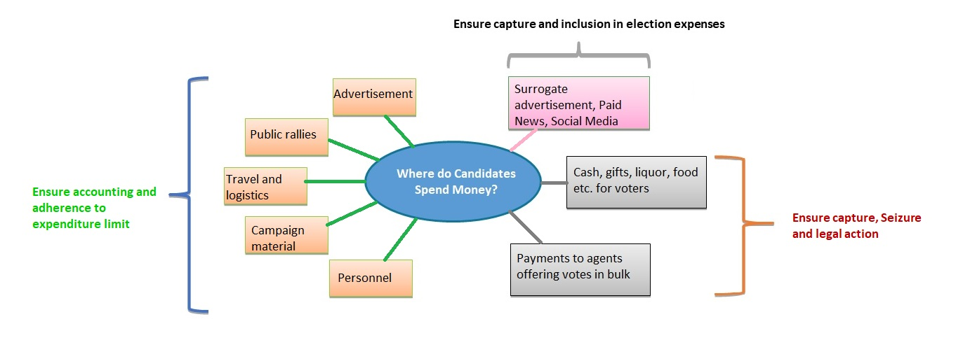
Types of Election Expenditure - Graphic

Slide 11
Where money goes?
Posters and banners
Wooing voters: gifts like food, clothes, trips and individual benefits.
Organizing crowd: price ranging from Rs 1000 to Rs 5000.
Dummy candidates: to cut into the rival's votes.
Commuting costs: Provision of petrol and diesel for campaigners
Temporary offices: On an average, Rs 10,000 to Rs 15,000 a day
Full-time party workers: Each candidate has at least 100-150 full-time party workers - paid daily ranging from Rs 500 to Rs 2,000.
Transport: To ferry voters jeep/taxi/bus costs from Rs 6,000 to Rs 10,000 a day for meetings/rallies.

Slide 12
Major legal provisions
Representation of the People Act, 1951
Conduct of Elections Rules, 1961
Indian Penal Code, 1860
Case laws
Instructions of the ECI

Slide 13
Major Legal Provisions- RPA, 1951
S 10 A:
Disqualification for failure
to lodge account of election
expenses
Failure to lodge an account of election expenses within time and manner required by law and has no good reason or justification for the failure
• Disqualification for a period of three years from the date of order of the Commission
S 77 (1): Account of Election expenses
and maximum thereof
Candidate/Election agent shall keep a separate, correct account of election expenditure incurred/authorized between date of nomination & declaration of results (both date inclusive).
Explanation 1(a) of c 77(1): Leaders of Political party (Star Campaigners)
The Expenditure incurred by leaders of the political party on account of travel by air or by any other means of transport for general party propaganda
Contd…

Slide 14
Major Legal Provisions- RPA,1951 – contd.
Such expenditure shall not be deemed to be the expenditure in connection with the election incurred or authorized by the candidate of that political party.
Explanation 1(a) of
S 77(1)
Explanation 2 of S 77(1)
Star Campaigners: (i) For recognized party, a list of 40 names and (ii) for unrecognized party, a list of 20 names are required to be communicated to the ECI and CEOs of the States by the political party within a period of 7 days from the date of notification.
S 78: Lodging of Account with District Election Officer
Within 30 days from the date of result, contesting candidate has to lodge with DEO "true copy" of election expenses kept by him/election agent (if 30th day is Sunday/public holiday then next working day will be the 30th day for lodging of account)
Contd…

Slide 15
Major Legal Provisions- RPA,1951 – contd.
The following acts amount to an electoral offence:
Election pamphlet/poster which does not bear the name & addresses of the printer/publisher.
Declaration as to the identity of the publisher is to be sent to the printer signed by publisher and attested by 2 persons personally known to him
Copy of the declaration and the document should be sent by the printer to the CEO/District Magistrate as per location
Imprisonment up to 6 months or fine up to Rs. 2000 or both)
S 127A:Restrictions on the printing of pamphlets, posters, etc.

Slide 16
Major Legal Provisions- COER, 1961
Account of election expenses to be kept by candidate/election agent to contain following items regarding daily election expenditure:
Date of expenditure incurred/authorized
Nature of expenditure
Amount of expenditure - amount paid and amount outstanding
Date of payment
Name and address of payee
Serial no. of voucher in case already paid
Serial number of bills in case of payment outstanding
Name and address of person to whom amount outstanding is payable
All vouchers to lodged along with election expense account chronologically and serially numbered
R86:Particulars of account of election expenses
Contd…

Slide 17
Major Legal Provisions- COER, 1961 – contd.
Any person can inspect accounts lodged by candidates on payment of Rs. 1 Fee.
Entitled to obtain attested copies of accounts/any part of such account lodged on payment of fee as fixed by ECI
R 88: Inspection of accounts and obtaining copies thereof
Contd…

Slide 18
Major Legal Provisions- COER, 1961 – contd.
(1) After expiration of the time as prescribed under S78 RPA 1951 regarding lodging of accounts, DEO shall report to ECI specifying:
Name of each contesting candidate
The date on which it was lodged
Whether a/c lodged in time and in manner required by the Act and the Rules
(2) If not lodged in manner, then DEO shall forward the account of such Candidate to ECI attaching the account of expenses and vouchers
(3) Publish copy of report on his notice board
(4) ECI to consider the report as to whether a/c is lodged in time and in the manner by the contesting candidate
(5) Commission issues notice to the candidate under S10A RPA 1951. if account is not lodged in time and manner required by the Act & Rules
R 89: Report by the [DEO] as to the lodging of account of election expenses and the decision of the ECI thereon
Contd…

Slide 19
Major Legal Provisions- COER, 1961 – contd.
6) Candidate to represent in writing within 20 days of receipt of notice to ECI with a copy to DEO together with complete a/c of his election expenses, if he had not earlier furnished such a/c.
(7) DEO shall forward representation and account (if any) of the candidate within 5 days of receipt of the representation with his comments as he wishes to ECI.
(8) If, after considering representation and comments of the DEO and after such enquiry as it thinks fit, ECI is satisfied that the candidate has no good reason or justification for the failure to lodge his account, it shall declare him to be disqualified under S10 A for a period of 3 years from the date of the order to be published in the Official Gazette
R 89:
Contd…

Slide 20
Major Legal Provisions- COER, 1961 – contd.
Any expense by candidate over and above the ceiling prescribed under R90 of COER, 1961
Election petition against any winning candidate in High Court on the ground of incurring expenditure in excess of maximum ceiling.
Election Expenditure above ceiling-a corrupt practice

Slide 21
Indian Penal Code, 1860
171 B-Bribery
Any person giving or accepting gratification to induce a person to exercise his electoral right would commit the offence of bribery.
Gratification - Offering gratification, agreeing to give gratification, attempting to procure gratification for doing an act against one's will shall be deemed as giving gratification.
171 E- Punishment for bribery
One year imprisonment or fine or with both.
Bribery by treating (food, drink, entertainment, or provision) shall be punished with fine only
171 C-
Undue influence at elections
Any act which voluntarily interferes or attempts to interfere with the free exercise of any electoral right.
171 F -Punishment for undue influence at elections
One year imprisonment or fine or with both.
Contd…

Slide 22
Indian Penal Code, 1860 – contd.
171 H-Illegal payments in connection with an election
Expenditure done by any person/ organization for a candidate without his written permission would considered illegal whether the be expenditure is in relation to a public meeting, advertisements, publication or in any other way.
1711-Failure to keep election accounts
If the candidate/his election agent does not maintain an account of his election expenditure in the manner specified by ECI
Punishment for not maintaining accounts
A fine up to 500.

Slide 23
Case Laws
Common Cause Vs UOI & Ors. (1996 SC 3081) lodging of expenditure accounts by the political party- within 75/90 days of completion of Assembly/Lok Sabha election (ECI letter no. 76/EE/2012-PPEMS, dated 21.01.2013)
Kanwar Lal Gupta Vs Amar Nath Chawla (AIR 1975 SC 308) is guiding principle to distinguish between the expenditure of a party and the candidate of that party.
Contd…

Slide 24
Case Laws – contd.
Rahim Khan Vs Khursheed Ahmed and Ors. (AIR 1975 SC 290) Strict enforcement of S 127A of RPA, 1951 like indicating name and address of publisher and printer in print line of any pamphlet, poster other materials and sending printed materials to appropriate authority within 3 days of printing. Printer shall obtain declaration in prescribed format from publisher in Appendix A and send to the DEO/CEO.

Slide 25
Election Expenditure: Case Laws
The Hon’ble Supreme Court in L. R. Shivaramagowde Vs. T.M. Chandrashekhar ( AIR 1999 SC 252 ) has observed that the Election Commission of India can go into the correctness of the account of election expenses filed by the candidate; and disqualify a candidate under S10 A of RPA, 1951 in case the account is found to be incorrect or untrue.
Contd…

Slide 26
Election Expenditure: Case Laws – contd.
The Hon’ble Supreme Court decision in SLPs- Ashok Shankarrao Chavan Vs. Dr. Madhavrao Kinhalkar & Ors.(2011), Madhu Kora Vs. Election Commission of India (2012) and Umlesh Yadav Vs Election Commission of India & Ors.(2013) dated 5th May, 2014 had observed,
“S 10A clothes the ECI with the requisite power and authority to enquire into failure to submit the account of election expenses in the manner prescribed and as required by or under the act”
SC upheld the Commission’s decision to disqualify Umlesh Yadav under S 10A, a returned candidate from 24-Bisaulli AC, Uttar Pradesh, General Election to Uttar Pradesh Legislative Assembly, 2007.

Slide 27
EEM as ethical election management
In pursuance of the judgement passed by hon’ble supreme court in writ petition(civil no. 536 of 2011) Public Interest Foundation and others vs UOI. The ECI has given the direction to be followed by candidates and political parties, as follows-
Candidate with criminal antecedent has to publish the details in Format C1 and report to DEO in Format C4.
Political parties who set up candidates with criminal cases also publish and broadcast in Format C2 and report to CEO in Format C5.
Contd…

Slide 28
EEM As ethical election management: Publication of Criminal Antecedents of Candidates – contd.
Duration of publication
Within four days of withdrawal
Between 5th - 8th day
From 9th day till the last day of campaign (the 2nd day prior to the date of poll)
Contd…

Slide 29
EEM as ethical election management – contd.
Recently, ECI in its order dated 6th March 2020 has directed that it shall be mandatory for political parties to upload on their website and publish in vernacular and national newspaper and social media platform of the political parties the detailed information regarding individuals with pending criminal cases who have been selected as candidates, in Format C7 within 48 hrs of the selection of the candidate, and in this regard a report should be submitted to ECI within 72 hrs of the selection of the said candidate.

Slide 30
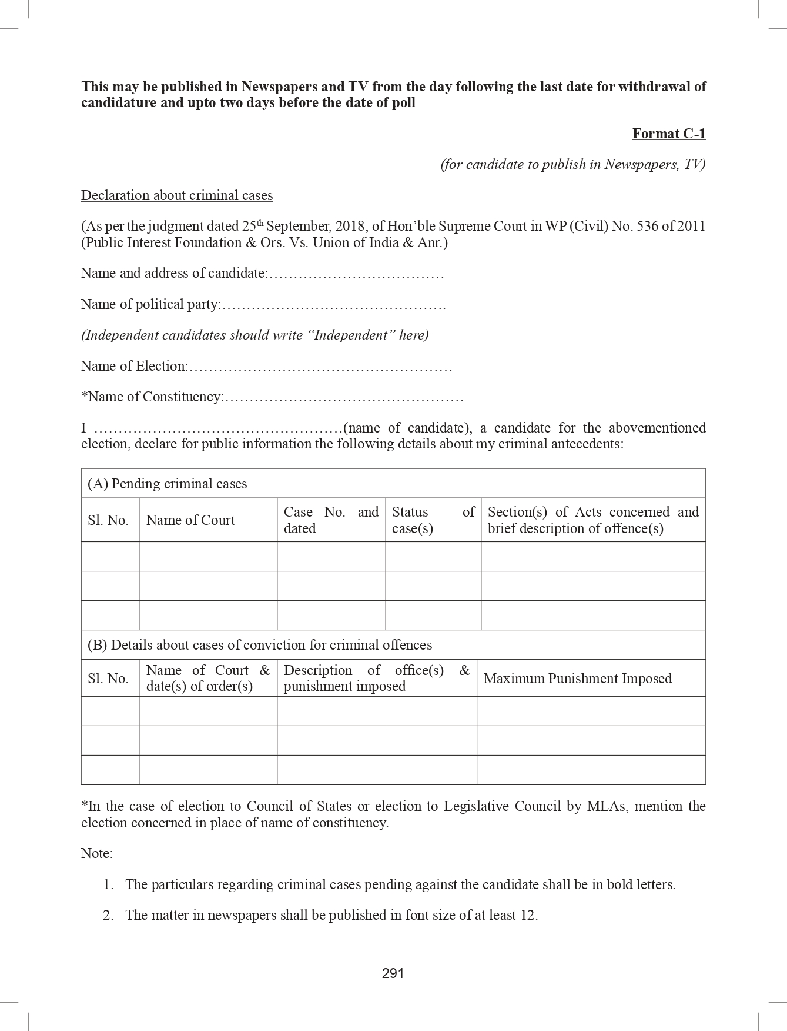
FORMAT C1

Slide 31
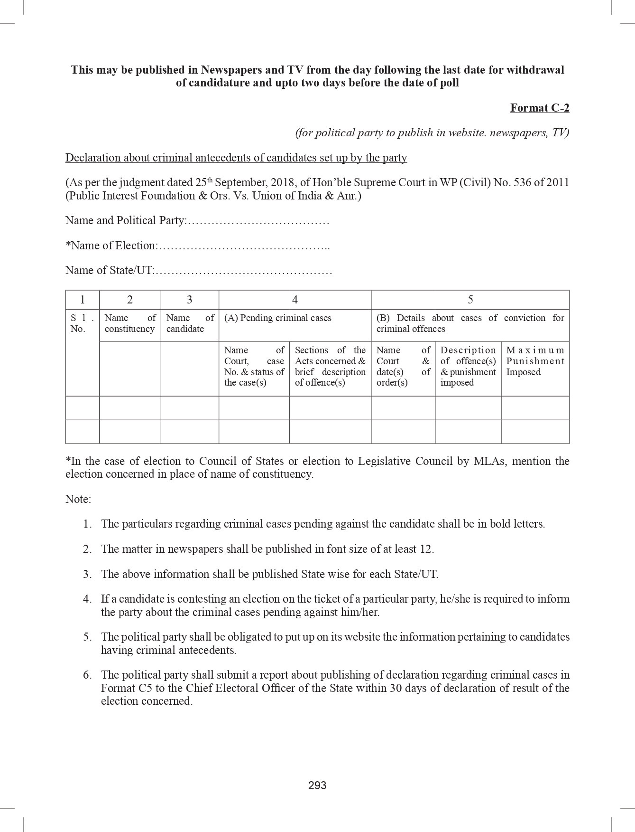
FORMAT C2

Slide 32
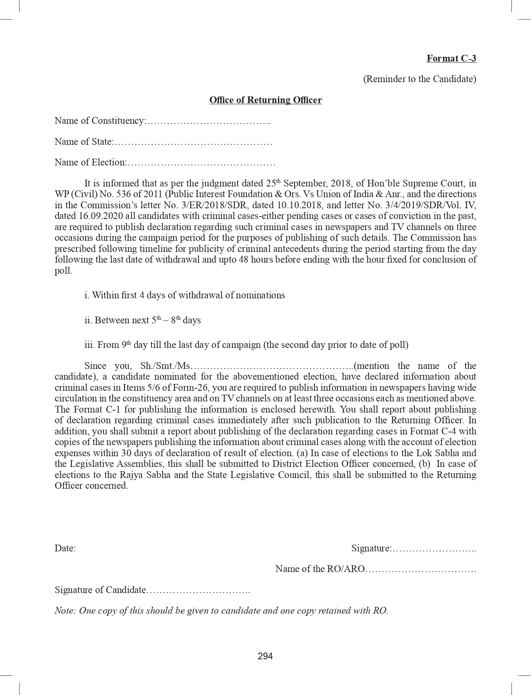
FORMAT- C3

Slide 33
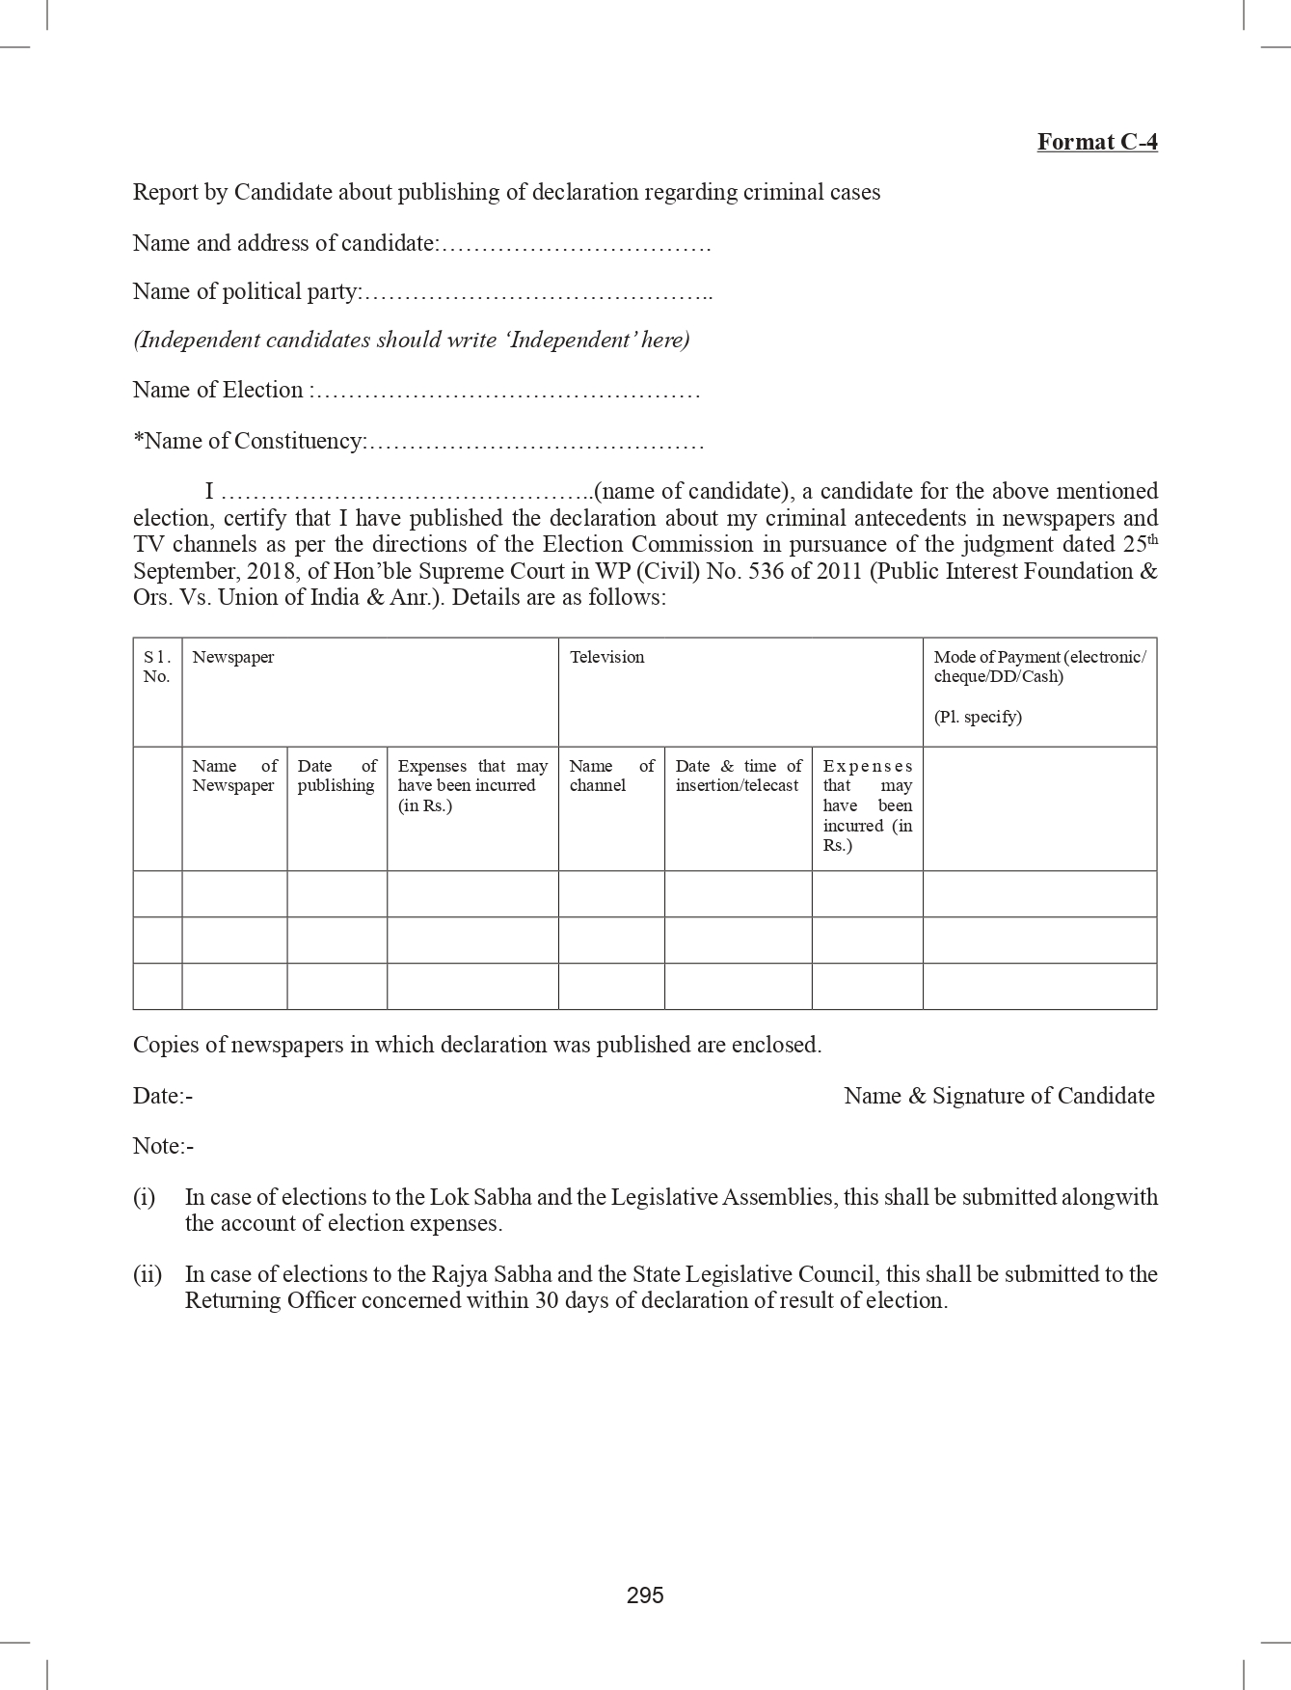
FORMAT C4

Slide 34
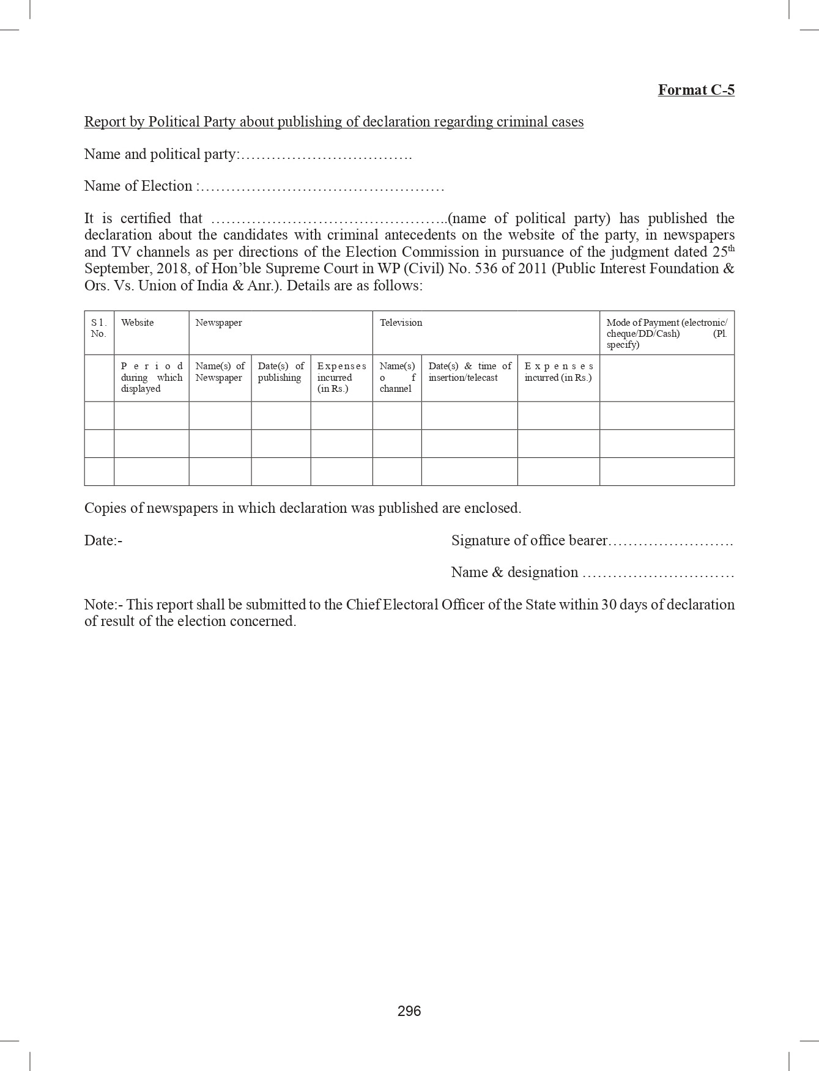
FORMAT C5

Slide 35
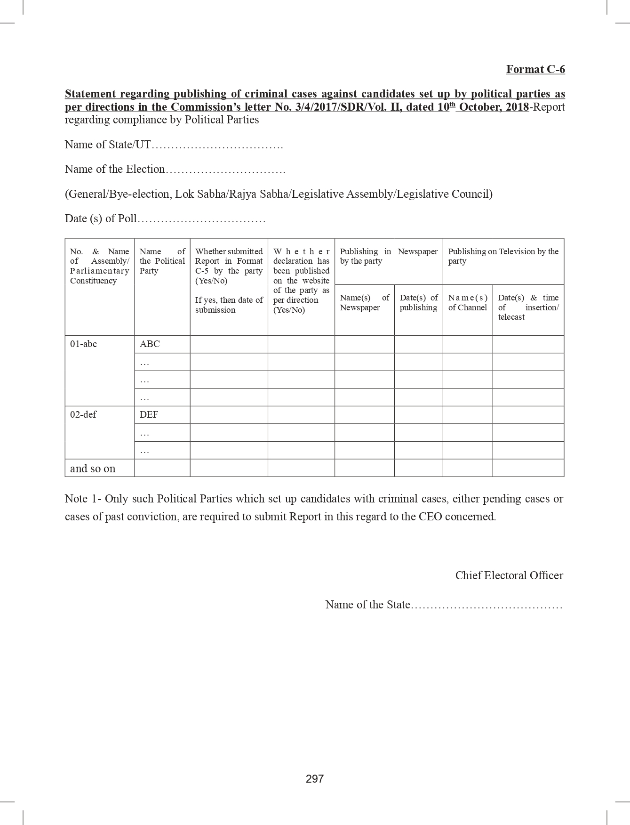
FORMAT C6

Slide 36
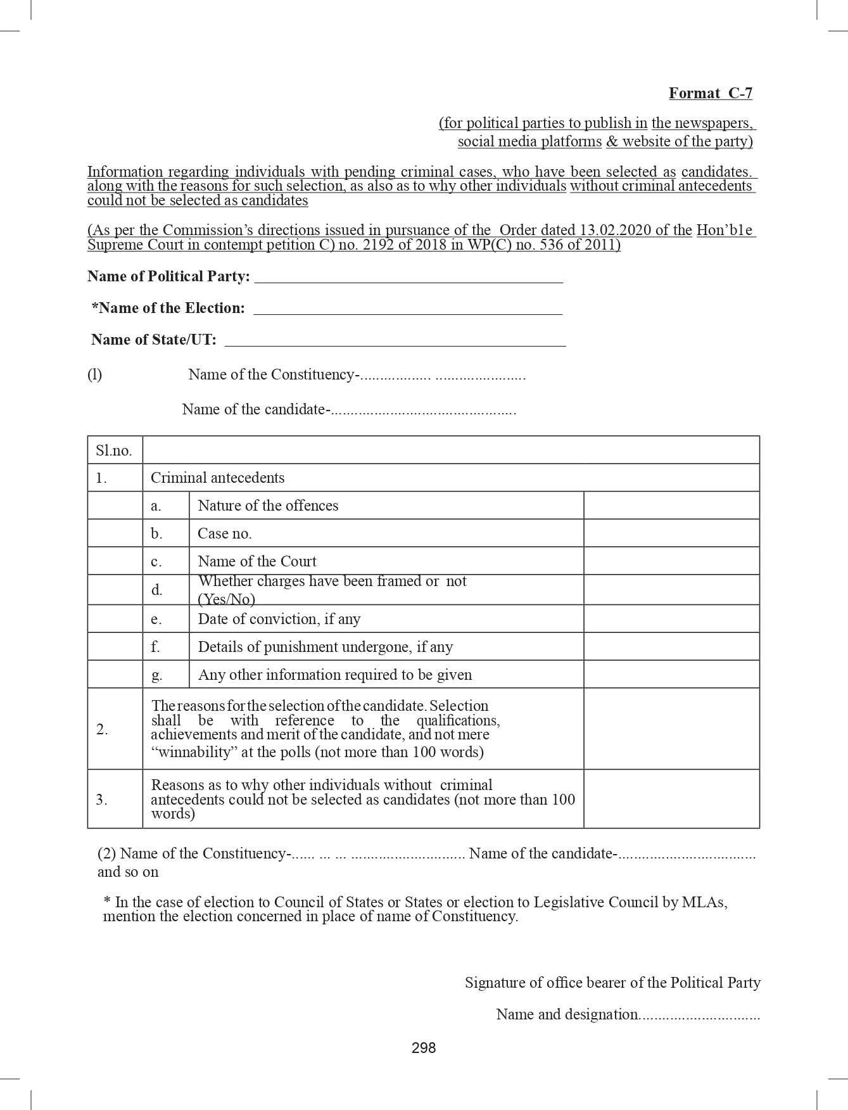
FORMAT C7

Slide 37
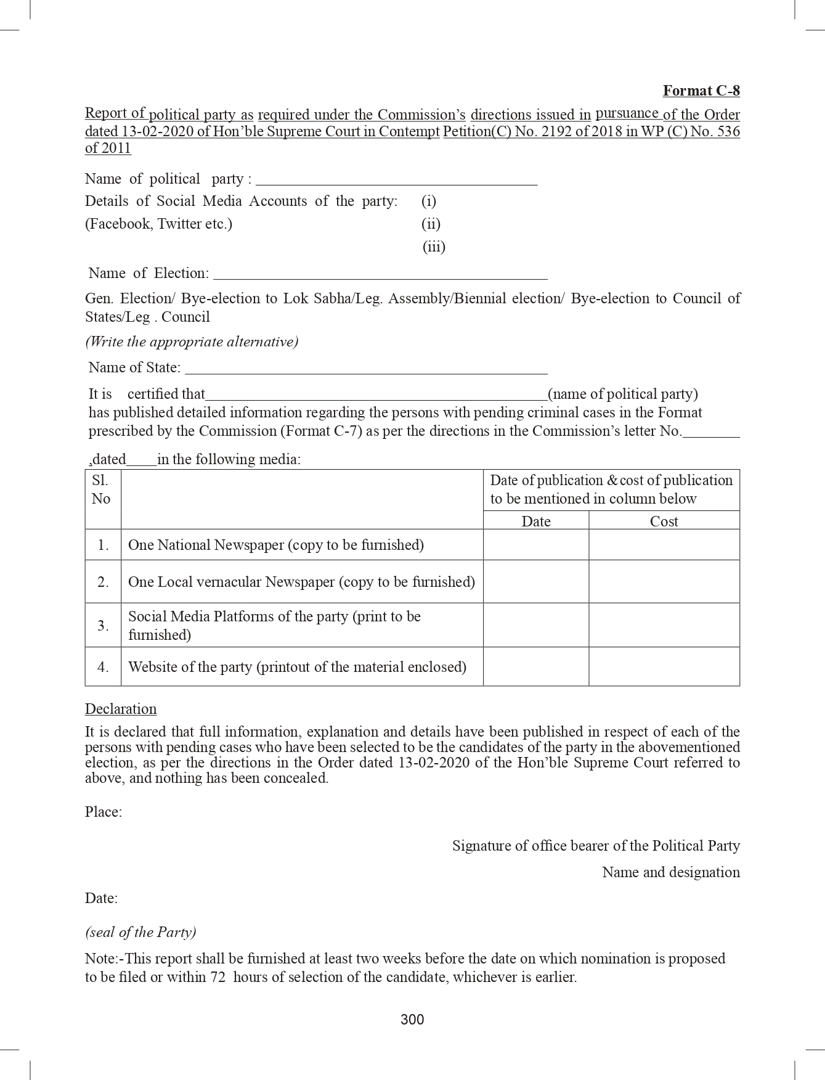
FORMAT C8

Slide 38
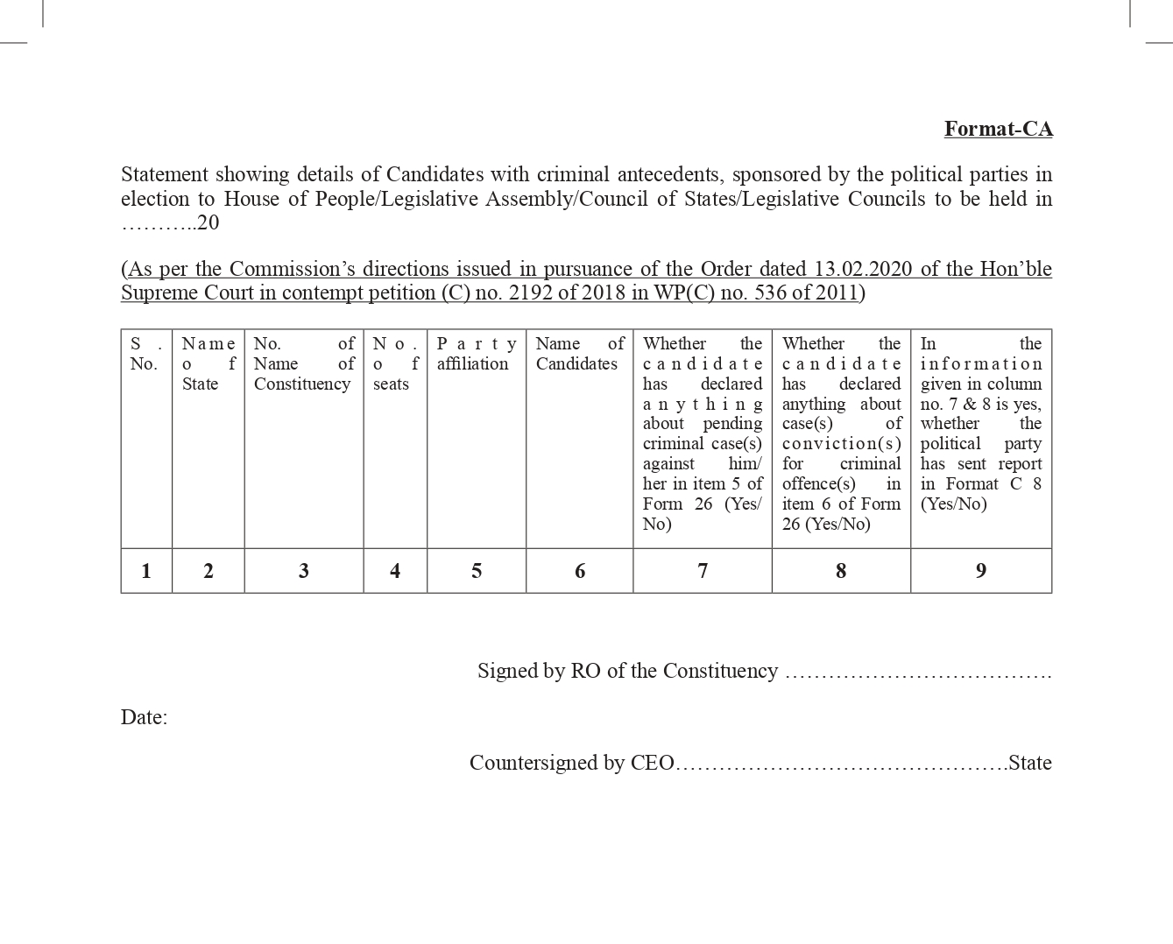
FORMAT CA

Slide 39
Part – C
Structure and functions of EEM organs

Slide 40
Expenditure monitoring machinery
Expenditure Observer (EO)
Asst. Expenditure Observer (AEO)
Flying Squads and Static Surveillance Teams (FS and SST)
Video Surveillance Teams (VST)
Video Viewing Team (VVT)
Accounting Team
Excise team
Media Certification and Monitoring Committee (MCMC)
District Expenditure Monitoring Committee (DEMC)
32
Contd…

Slide 41
DEO
Expenditure Observer
Expenditure Monitoring Cell
R.O.
AEO
MCMC
(Dist./ State Level)
Complaint monitoring control room & 24x7 Call Centre
Expenditure monitoring machinery - graphic
Accounting Team
(SOR / FE )
VVT
SST
VST
F S
Public meeting/Rally

Slide 42
Expenditure Observer (EO)
EO is responsible for overall supervision of expenditure monitoring.
He is deployed for two or more Assembly segments, but not more than five ACs.
More AEOs for Expenditure Sensitive Constituencies (ESCs)
He will inspect functioning of different teams engaged in expenditure monitoring in each constituency and inspect the accounts of the candidates
He will coordinate with various law enforcement agencies of Income tax, Police, BSF/SSB, State Excise and DRI

Slide 43
Visit of Expenditure Observer
To reach the constituency on the day of notification of elections(ANNEXURE -B1),
EO to leave the constituency after submitting the poll preparedness Report-B2,
2nd Visit on date immediately after the date of withdrawal of candidature and remain in the constituency during entire campaign period and leave the constituency only after the completion of poll and sending his Report-B3,
Third report after the poll (ANNEXURE-B4),
3rd visit after 25 days from declaration of results to assist in finalisation of scrutiny report prepared by DEO. He will send his final Report (ANNEXURE -B5) after that.
Contd…

Slide 44
Inspection of Accounts
Maintenance of account – periodic submission of account on 3 occasions:
Candidates are required to maintain their Day-to-Day accounts and produce them for inspection 3 times before the Expenditure Observer (EO). The RO will notify 3 dates & timing well in advance in consultation with EO for such inspection.
Gap between the two inspections should not be less than 3 days.
A candidate can have a separate agent for election expenses.
Contd…

Slide 45
Visit of Expenditure Observer – first visit – to do list – contd.
Ensure AEOs and monitoring teams are properly trained by DEO and you.
Ensure proper preparation and equipping of various expenditure monitoring teams with relevant registers/formats.
Conduct a meeting with DEO, SP, District Nodal Officer of Income Tax, State Excise and other District Nodal Officers of enforcement agencies.
Ensure that the rate chart is notified by the DEO and is ready to be provided by the RO to prospective contesting candidates, political parties and expenditure monitoring teams. Any objection on rates have to be addressed appropriately by the DEO.
Contd…

Slide 46
Visit of Expenditure Observer – first visit – to do list – contd.
Ensure Expenditure Register is ready for providing to all prospective candidates.
Ensure that DEO has held meeting(s) with all political parties and has provided them copies of Expenditure Instructions.
Timely filing of Annexure B2 – “Observer’s Report No 1”.
Contd…

Slide 47
Visit of Expenditure Observer – second visit – to do list – contd.
Fixation of dates for inspection of candidates’ election expenditure register.
Obtain daily activity report/feedback from the DM, SP and Income Tax Department, Excise for keeping surveillance on distribution of cash, liquor and other goods.
Ensure that candidates are apprised of the procedure of Expenditure Monitoring by Returning Officer and Expenditure Observer.
Ensure Banks are reporting suspicious cash withdrawals to DEOs and it is analysed.
Ensure that seizure of cash exceeding ₹10 lakh is being reported to Income Tax Department by Flying Squad (FS)/Static Surveillance Team (SST)/Police.
Contd…

Slide 48
Visit of Expenditure Observer – second visit – to do list – contd.
Ensure that the seized cash/goods are linked to election expenditure.
More FSTs and SSTs with CAPF should be placed in Expenditure Sensitive Constituencies, Expenditure Sensitive Pockets along with 24x7 check-posts during the last 72 hours before poll.
For Expenditure Sensitive Constituencies (ESCs), more AEOs should be provided.
Ensure suspect cases of paid news case are referred to District Level MCMC.
Ensure Shadow Observation Register and Folder of Evidence are being properly maintained.
Ensure entry of expenditure of all major public meetings/rallies/procession in Shadow Observation Register of the candidate concerned.
Contd…

Slide 49
Visit of Expenditure Observer – second visit – to do list – contd.
Ensure monitoring of liquor production/distribution reports during election period, especially in ESPs.
Ensure that all ostentatious expenditure like marriage/group marriage ceremony, are reported to DEO/Income Tax Department.
Ensure VST, Accounting Team and Media Monitoring Team are getting copies of permissions granted by concerned authorities for expenses such as vehicles, public meetings, rallies and processions.
Ensure C-Vigil Android App is effective from complaint registration to resolution.
Submit Expenditure Observer Report II and III.
Contd…

Slide 50
Visit of Expenditure Observer – third visit – to do list – contd.
Attend Account Reconciliation Meeting to be organised by DEO on 26th Day to declaration of election results.
Attend District Election Expenditure Monitoring Committee (DEMC) meeting to resolve the issues of account lodged by contesting candidates.
Help the DEO in timely preparation of candidate-wise DEO’s Scrutiny Reports.
Scrutinize DEO’s Scrutiny Report and counter-sign at designated place.
Submit Expenditure Observer Report IV.

Slide 51
Focus areas: 1. Accounting of publicity of criminal antecedents
In pursuance of SC Order (reference: WP(C) No.536 of 2011) and press release by Commission dated 11.09.2020, timeline for publicity has been given) -candidates as well as the political parties, regarding candidates nominated by them, will publish the details of criminal antecedents.
Publicity- 3 times: Timelines
First publicity:
Within first 4 days of last date of withdrawal
Second publicity:
Within 5th to 8th day of last date of withdrawal
Third publicity:
From 9th day till the last day of campaign, i.e. two days before the poll
Contd…

Slide 52
Focus areas:
2. Visit in ESPs and Monitoring of flow of liquor, drugs, cash
Visits to Expenditure Sensitive Pockets (ESPs) and contribute to stepping up of enforcement agencies in such areas. Have route maps of passage of liquor, drugs, cash from the agencies for closer monitoring.
Conduct an analysis of places where high number of seizures of cash/liquor were made in previous two elections, and ensure that special vigil is maintained.
Interact with District Excise Authorities regularly for effective action against flow of liquor meant for vitiating electoral process. Ensure close monitoring of sensitive liquor shops as per guidelines in compendium and extant laws.
Contd…

Slide 53
Focus areas:
3. Activities related to Accounts of Candidates
‘Shadow Observation Register’ to be maintained neatly and cross-referenced with evidence.
Issuance of notice on the same day by RO in cases of discrepancies observed during inspections.
Despite notice by the RO if the account is not getting inspected then, FIR to be filed by RO.
Ensure that there is decent publicity for dates of inspection and the account details are properly displayed.
Educate and guide candidates to avoid minor defects like routing the expenses through separate bank account, expenditure over ₹10,000/- to be incurred through banking channels, vouchers to be signed, etc.
Contd…

Slide 54
Focus areas: 4. Activities related to proactive engagement with enforcement agencies
Ensure proper seamless coordination happens among various agencies including Income Tax, Police, CGST/SGST, State Excise, DRI, NCB, BSF, Railway, Coast Guard, Postal Department, SLBC etc.
Ensure quick flow of communication amongst agencies for increased deterrence.
Regular follow-ups with district level officers from enforcement agencies.

Slide 55
Expectations from Expenditure Observers
Thorough reading of Expenditure Monitoring Compendium.
The roles and duties assigned in each visit to be carried out diligently and pro-actively.
Coordination with various enforcement agencies through district level nodal/nodal officers and monitoring them on daily basis.
Monitoring the handling of complaints from C-Vigil pertaining to expenditure monitoring.
Physical availability and access through mobile phones for citizens and stakeholders.
Contd…

Slide 56
Expectations from Expenditure Observers – contd.
Proactive reporting of sensitive cases/high end seizures to CEO/Commission.
Priorities- Liquor, Drugs, Cash and freebies as inducements meant to vitiate electoral process.
Visit to Expenditure Sensitive Pockets and monitor arrangements. 81 ACs have been classified as Expenditure Sensitive Constituencies (ESCs) and needs more monitoring.
Enhances monitoring and surprise vigils during last 72 hours before the poll.
Catalyse information sharing amongst agencies.
Special monitoring to ensure proper checking of passengers and baggage in non-regular airports and helipads.
Special monitoring of border areas as Karnataka has long borders.

Slide 57
Assistant Expenditure Observer (AEO)
AEO to be appointed by DEO
The EO may replace the AEO, if not found to be up to the mark
To tour extensively and make an assessment of election expenditure by candidate
To maintain the Shadow Observation Register & Folder of Evidence
Supervise and ensure all complaints are addressed w.r.t election expenditure by candidate in his jurisdiction
Co-ordinate with the RO’s office on campaign activities of candidates
Assist EO in inspection of accounts
Extra AEO in case of ESC

Slide 58
AEO’s Daily Report

Slide 59
Flying Squads (FSs) and Static Surveillance Teams (SSTs)
SOP for seizure and release of cash and other items, ECI letter dated 29 May 2015
3 or more Flying Squads(FS) and Static Surveillance Teams(SST) in each Assembly Constituency/Segment.
FS-More in Expenditure Sensitive Constituencies(ESC) if required.
SST- required at Expenditure Sensitive Pockets (ESP).
Headed by a Magistrate (Adequate numbers/ gazette notification).
Video Recording.
GPS enabled FS vehicles/ Mobile tracking.

Slide 60
Flying Squads
FS- to attend to all complaints related to MCC
Attend all complaints of threat, movement of liquor, arms and ammunition and large sum of cash for the purpose of bribing of elections etc.
Attend to all complaints regarding election expenditure by the candidates / political party
Videograph with the help of VST, all major expenses made by political parties after the announcement of election .

Slide 62
Static Surveillance Teams (SSTs)
Two or more SSTs in each AC with one magistrate, 3-4 Police personnel and one videographer.
To put the check post on major roads to check movement of illegal cash/liquor/arms or gift items
Flying Squad of the district will supervise the posting of the Static Team/Check Post so as to avoid any harassment of public.
Contd…

Slide 63
SSTs – contd.
Videography is must and the DVD handed over to Accounting Team, for keeping in `folder of evidence`.
Any member of public may ask and take copy the Video DVD/CD for a particular day by depositing Rs. 300/-.
Daily Activity report in prescribed format (Annexure-B10) to SP, RO and Assistant Expenditure Observer
Nodal officer of Police HQ to compile and submit report to CEO and Commission
EO to have coordination meeting with all law enforcement agencies of district and the teams.
Contd…

Slide 64
SSTs - cash limits for seizure – contd.
During checking, if any cash exceeding Rs. 50,000 is found in a vehicle carrying a candidate, his agent or party worker or carrying posters or election materials or any drugs, liquor, arms or gift items which are valued at more than rs.10,000 , likely to be used for inducement of electors or any other illicit articles are found in a vehicle, shall be subject to seizure.
The whole event of checking and seizure is to be captured in a video/CCTV, which will be submitted to the RO, everyday.
Contd…

Slide 65
SSTs - cash limits for seizure – contd.
If any star campaigner is carrying cash upto Rs.1 lakh, exclusively for his/her personal use, or any party functionary is carrying cash with certificate from the treasurer of the party mentioning the amount and its end use, then the authorities in SST shall retain a copy of the certificate and will not seize the cash
If cash of more than Rs.10 lakh is found in a vehicle and there is no suspicion of commission of any crime or linkage to any candidate or agent or party functionary, then the SST shall not seize the cash, and pass on the information to the Income Tax authority, for necessary action under Income Tax laws.

Slide 67
Seizures in last five general elections
(in ₹ Crores)
States | Cash | Liquor | Narcotics | Precious Metals | Freebies | Total (2022/23) | Total (2017)
Tripura | 3.45 | 3.20 | 26.82 | 3.41 | 8.56 | 45.43 | 1.79
Nagaland | 6.30 | 5.09 | 32.87 | 0.00 | 5.76 | 50.02 | 4.30
Meghalaya | 8.71 | 2.62 | 33.25 | 0.91 | 28.69 | 74.18 | 1.16
Gujarat | 31.92 | 16.40 | 540.63 | 36.51 | 176.39 | 801.85 | 27.21
Himachal Pradesh | 20.61 | 19.13 | 1.23 | 15.85 | 0.42 | 57.24 | 9.03
Karnataka | 153.17 | 84.93 | 24.03 | 98.07 | 24.26 | 384.46 | 83.93

Slide 68
Seizures in 2022
(in ₹ Crores)
States | Cash | Liquor | Narcotics | Precious Metals | Freebies | Total (2022) | Total (2017)
Uttar Pradesh | 103.56 | 62.13 | 48.48 | 40.71 | 94 | 348.88 | 193.29
Uttarakhand | 4.37 | 4.75 | 5.39 | 4 | 0.3 | 18.81 | 6.85
Manipur | 6.14 | 0.73 | 143.78 | 12.17 | 7.42 | 170.24 | 6.42
Punjab | 33.79 | 36.79 | 376.19 | 60.54 | 3.6 | 510.91 | 89.64
Goa | 6.66 | 3.57 | 1.28 | 0.02 | 1.2 | 12.73 | 3.64
Total | 154.52 | 107.97 | 575.12 | 117.44 | 106.52 | 1061.57 | 299.84

Slide 69
Increase in seizures- Analysis
Factors helping detection of flow of illegal cash/goods:
Possible because of active involvement of enforcement agencies.
Possible because of proactive efforts taken by expenditure observers.
Possible because of coordination amongst enforcement agencies where EO has to show leadership.
Possible because of proper training, guidance and handholding done by you.
Possible because of clues taken out of successful case studies.
Possible because of momentum provided by you.

Slide 70
Video Surveillance Team (VST)
Video Surveillance Team (VST)
Minimum One official, one videographer and one vehicle
Properly trained to identify and capture MCC and expenditure related events in adequate minute details as required
This team will prepare a video cue-sheet in the format given at Annexure-B15 of the instructions.
At the end of shooting, the team may also record in voice mode the estimated number and type of vehicles, Chairs, furniture, approx size of rostrum/banner/poster/cutout etc. used in the event.
At the beginning of shooting, the team will record in voice mode the title and type of event , date, place and the name of the party or the candidate organizing the same.
It will capture the photo in such a way that the evidence of each vehicle, furniture, rostrum, banner, cutout etc. can be seen clearly and the expense thereon can be estimated
Can be more than 1 team at a public meeting
Contd…

Slide 71
Video Viewing Team (VVT)
Video Viewing Team (VVT)
Submit report containing candidate wise expenditure no later than next day to Accounting Team/ Asst. EO, MCC related report to General Observer and RO
View Video CD provided by VST for identifying election expenditure and MCC related issues
1 officer and 2 clerks (or as required) for each assembly segment ,as viewing all CD’s is a time consuming task,

Slide 72
Accounting team
Accounting Team
One official and one accounting clerk per segment
Drafted from employees of accounts wing of Central Govt. depts.
Will enter expenditure incurred by the candidate on major expenses and corresponding notified rates against each item( major public meetings/rallies) in the Shadow Observation Register, reported by various teams and calculate the total expenditure of the event observed for each candidate.
Work under Asst. EO, involved in preparation of Shadow Observation Register and maintaining videos/ CD evidences carefully in Evidence Folder. To maintain proper back-up which can be called by Commission later.

Slide 73
Excise Team MONITORING PRODUCTION, STORAGE AND DISTRIBUTION OF LIQUOR
From the date of announcement of election till completion of election, the production, off-take, stock limits of stockiest and retailers of IMFL/Beer/country liquor are to be monitored district wise;
Opening and closing of liquor vending shops are to closely monitored;
Intensive vigil over inter state movement of vehicles at dist check-posts and border check-posts by special enforcement staff of Excise Dept.;
To conduct raids to seize illicit liquor;
Inter state coordination of Excise Commissioners of the bordering states;
District level Nodal Officer to submit report every alternate day to DEO, Exp. Observer and State Level Nodal Officer, who will compile the state level report to Commission and CEO;
All distilleries/ warehouses shall be put under 24x7 CCTV monitoring with police guard so that no liquor is released without license.

Slide 74
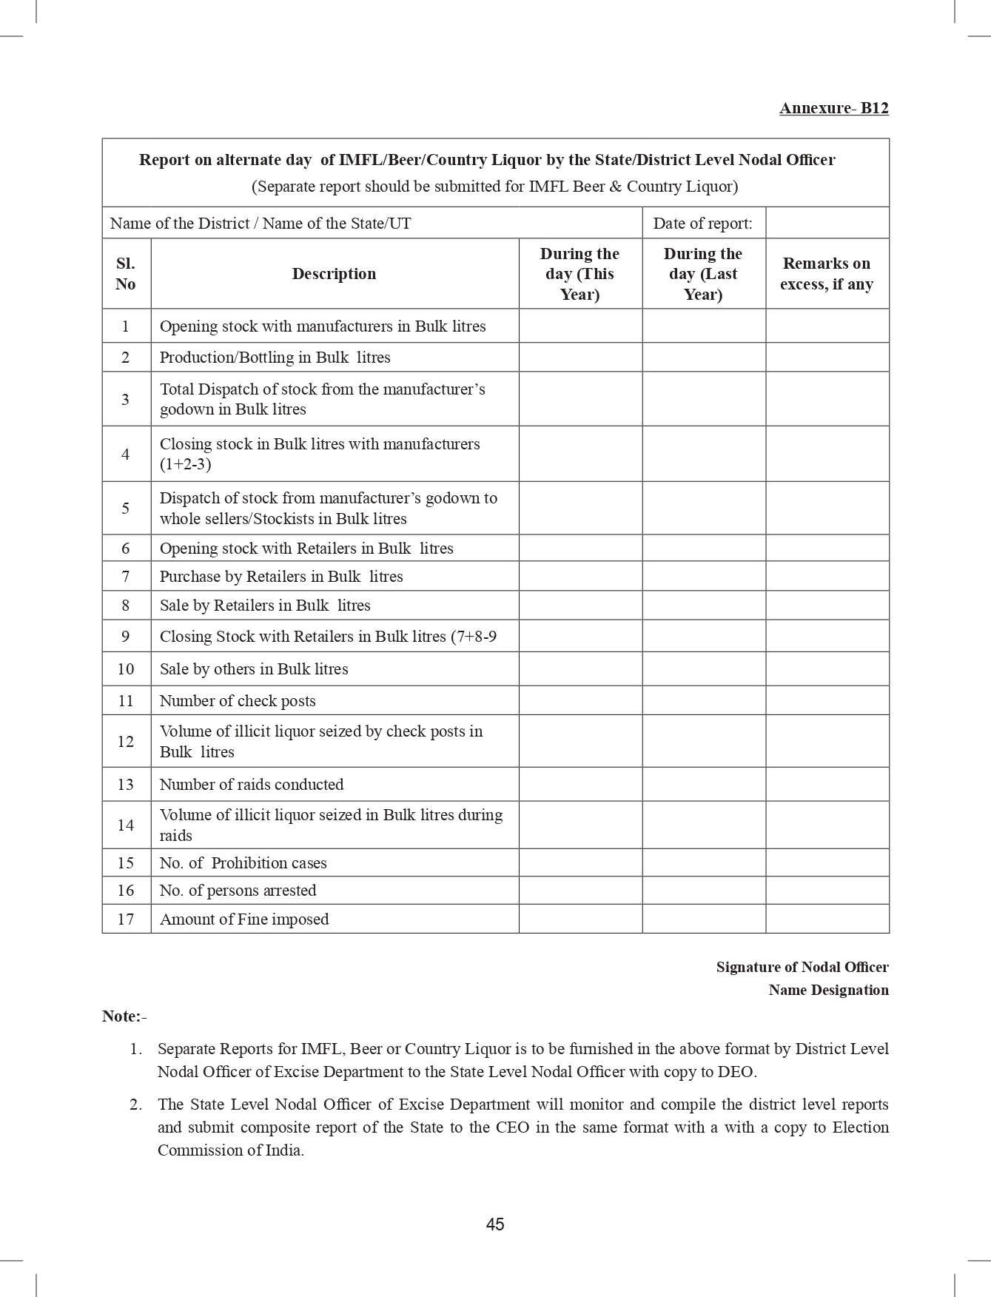
Excise Report

Slide 75
EXPENDITURE MONITORING CELL (EMC)
This cell at district level will consist of a Nodal Officer on behalf of DEO, of the rank of SDM/ADM and two officials, who will be in charge of expenditure monitoring training and coordination with all other team heads engaged in expenditure monitoring
It will be responsible for expenditure monitoring efforts in the district, providing manpower and logistical support like space and equipment
Training of the Asst. Expenditure Observers (AEOs) and all the officials engaged in various teams should be done by these Nodal Officers of Expenditure Monitoring Cell in the District as soon as the elections are announced
Contd…

Slide 76
EXPENDITURE MONITORING CELL (EMC) – contd.
This cell will keep custody of all shadow observation registers and folders of evidence after the poll
Nodal Officer of Expenditure Monitoring Cell shall act as the link between the DEO and the EO
EMC will assist the DEO and Expenditure Observer in finalizing the scrutiny report to be submitted after declaration of result.

Slide 77
24 X7 Complaint Monitoring Control Room
District level Control Room to operate from the date of announcement of election.
Toll free telephone no. with 3-4 hunting lines.
Copies of all complaints received and reports of inquiries conducted shall be put on the notice board of the RO for information of the public. Any member of the public can obtain copies of these documents on payment of a fee of ₹ 1 per page.
All complaints filed with District Level Complaint Monitoring cell to be recorded and investigated

Slide 78
MCMC
Certifying advt. proposals of candidates,
Infrastructure shall be functional for the DMCMC
A Dist. Level MCMC comprising DEO/RO, ARO ,Central Govt. I&B Official(if any) and 1 citizen/ journalist nominee of Press Council of India/ DPRO or DIO equivalent- member secy.
Scanning media for suspected ‘paid news’ and examination of complaints, reference by EO.
NB: District Level MCMC to operate 24x7
Contd…

Slide 79
MCMC – coverage –contd.
Print Media
Local Newspapers
Magazines
Electronic Media
Radio including Private FM
TV channels, cable network
Bulk SMS
Other newspapers in circulation in area
Pamphlets & Posters
Contd…

Slide 80
Contd…

Slide 81
MCMC – contd.
In case of suspected ‘Paid News’( any news or analysis appearing in any media for a price in cash or kind for consideration), the candidate to be issued notice for not accounting the expenses within 96 hours by RO.
Candidate may reply within 48 hrs, which shall be considered by District MCMC and shall be final.
In case of non acceptance of the decision of District MCMC, the candidate may appeal to State level MCMC (CEO, Observer appointed by ECI, Officer of IIS, journalist by PCI, One expert co-opted by committee, additional/ joint CEO) within 48 hours of receipt
In case of non acceptance of decision of State MCMC, the Candidate may appeal to ECI within 48 Hrs. of receiving of orders and the decision of the ECI shall be final.

Slide 82
Expenditure Sensitive Constituencies (ESC) Expenditure Sensitive Pockets (ESP)
ESC to be identified by CEO, based on profile of constituency candidates and past developments
Extra AEO in ESC
More FSs and SSTs with CPF
ESP to be identified by Sector officers or police in a constituency- based on level of education, development and demography
ESPs to be kept under close watch all the time
ESPs to have 24X7 check post during last 72 hours before poll
ESPs need more campaign for ethical voting
Liquor sale to be closely monitored in ESPs

Slide 83
DISTRICT EXPENDITURE MONITORING COMMITTEE (DEMC)
If Expenditure is not shown correctly in his account submitted within 30 days of declaration of result, a notice is issued on the candidate by DEO within 24 hours. The candidate shall submit his reply to DEO within 48 hours of the receipt of such notice explaining his position.
If candidate does not submit any reply on the suppressed amount of election expense or disagrees with such suppressed amount, the DEO mention the same in his scrutiny report submitted to the Commission.
If candidate does not file his statement of election expenses without any valid reasons within the stipulated period of 30 days from the day of declaration of result, then the DEO shall send the report to the Commission mentioning such default with his recommendation.
Contd…

Slide 84
DISTRICT EXPENDITURE MONITORING COMMITTEE (DEMC) – contd.
District Expenditure Monitoring Committee (DEMC) consisting of the following:
(a)Expenditure Observer in charge of the Constituency
(b)DEO
(c) Dy. DEO/Officer in charge of Expenditure Monitoring of the District.
The DEMC shall decide the case after examining the evidence mentioned in the notice and reply of the candidate, preferably within 72 hours from the date of receipt of the reply from the candidate, whether such suppressed expenditure shall be added or not
After the order by DEMC, the DEO may consider to include such expenses in the account of such candidate while sending the scrutiny report of the candidate to the Commission after election.
Contd…

Slide 85
District Expenditure Monitoring Committee (DEMC) – contd.
Candidates shall be given another opportunity in Account Reconciliation Meeting, to be convened by DEO on 26th day after declaration of result, to reconcile the under stated amount of election expenses, if any.
The candidates should come prepared with their final accounts of election expenses and registers, etc.,
DEMC, after scrutinizing the accounts, shall pass order in writing, giving detailed reasons in cases, where the differences could not be reconciled and serve it on the candidate/ agent on the same day,
If, candidate agrees, he may incorporate the same in his final accounts. If not, he may lodge his final accounts with DEO, with reasons for disagreement giving letter to DEO.
If account lodged prior to this meeting, the candidate may revise his accounts within the statutory period of 30 days

Slide 86
Role of RO: Before Announcement
To have the updated list of all the disqualified candidates, who have incurred disqualification S 8A and 11A (b) (for corrupt practices) and S 10 A (failure to lodge the account of election expenses in time and manner) of the RPA, 1951, which may also be viewed on Commission’s website www.eci.gov.in
To ensure that the following formats are ready at the o/o the RO:
Election Expenditure Register of the candidates (duly serial numbered comprising of Bank Register, Cash Register, Day to Day Account Register, Abstract Statement (Part I to Part IV) along with Schedules 1 to 11, Format of Affidavit and Acknowledgement.
Shadow Observation Register
Video Cue Sheet
Reporting formats by Flying Squad/Static Surveillance Team
Compendium of Election Expenditure guidelines in local language.
Form 26 regarding criminal cases, assets and liabilities.
Contd…

Slide 87
Role of RO: Before Announcement – contd.
To identify Expenditure Sensitive Pockets (ESPs), in the Constituency on the basis of level of development, literacy and complaints received during the last Assembly elections and to report to Commission.
To identify the Master Trainers of State Police and State Excise Department of the district for Expenditure Monitoring Team.
To pursue all pending cases of last election, where FIR was filed and take them to their logical conclusion.
To identify officers who will be notified as Executive Magistrate for the Flying Squad/ Static Surveillance Team.
To prepare plan for training of all manpower to be deployed in Expenditure Monitoring Teams in 2/3 phases.
To arrange vehicles for all teams and the logistics.
To interact with BAGs and sensitize them about their role in ethical voting campaign and provide information on malpractices during elections.

Slide 88
Role of RO: After announcement of election
To ensure that FS, VST, VVT, MCMC and Accounting team are functional from the date of announcement of election.
To ensure that GPRS is fitted in all FS/SST vehicles and the Flying Squads shall attend both the MCC cases and expenditure related cases within ½ an hour of receipt of complaint.
The expenses incurred by the political parties shall be observed from the date of announcement of election till completion of election and reported to CEO party wise, after declaration of result.
To file FIR in appropriate cases, as detected by FS, SST or EO.

Slide 89
Role of RO: After issuance of notification of elections
To ensure that SSTs are functional from the date of issue of notification.
Take note of the list of Star Campaigners received by the CEO and ECI within 7 days of notification of election.
To scan the affidavit of assets and liabilities submitted by the candidates and upload on to the CEO’s website within 24 hours of its receipt.
To hold a meeting of all the candidates or agents immediately after the allotment of symbols to explain the process of expenditure monitoring, legal provisions relating to election expenditure and consequences of non-compliance of these provisions.
Expenditure Register in prescribed format is ready to be handed over to the candidate
To notify date for inspection of accounts by the Expenditure Observer during the campaign period and issue notices to the defaulting candidates as directed by the Expenditure Observer.
To supervise complaint monitoring system and ensure that every complaint is enquired within 24 hours of its receipt.
Contd…

Slide 90
Role of RO: After issuance of Notification of Election – contd.
To ensure that all the documents required are put on his website and copies of the same, if requested, are given immediately to the members of public on payment of prescribed fee.
To ensure that after seizure by FS/SST, FIR/ complaint is filed promptly in appropriate cases.
To interact with Expenditure Observers/Assistant Expenditure Observers and to ensure that all teams are working smoothly.
To issue notice to the candidate, whey any defect is pointed out by the EO/DEO and received reply from the candidate/agent.
To issue notice to the candidate, preferably within 24 hrs. of the date of receipt of information about suppression/omission of the expenditure incurred by the candidate or if the candidate has not produced his account of election expenses for inspection on scheduled date or if the expenses incurred in election campaign are not correctly shown by the candidate.
To ensure that the reply of the notices issued to the candidates are received within 48 hrs.
Contd…

Slide 91
Role of RO: After issuance of Notification of Election – contd.
To have the updated list of all the disqualified candidates, who have incurred disqualification S 8A and 11A (b) (for corrupt practices) and S10 A (failure to lodge the account of election expenses in time and manner) of the RPA 1951, which may also be viewed on Commission’s website www.eci.gov.in
To ensure that the following formats are ready at the o/o the RO:
Election Expenditure Register of the candidates (duly serial numbered comprising of Bank Register, Cash Register, Day to Day Account Register, Abstract Statement (Part I to Part IV) along with Schedules 1 to 11, Format of Affidavit and Acknowledgement.
Shadow Observation Register
Video Cue Sheet
Reporting formats by Flying Squad/Static Surveillance Team
Compendium of Election Expenditure guidelines in local language.
Form 26 regarding criminal cases, assets and liabilities.

Slide 92
Common mistakes
Violation of provision related to publication/broadcasting of information of candidates criminal antecedent
Some candidates fail to open separate bank account for election expenditure
Some candidates do not show all transactions from the separate bank account
Some candidates fail to produce their account register for inspection to RO/EO at least 3 times during the election campaigning period.

Slide 93
Part – D
Monitoring of expenditure on election campaign

Slide 94
Monitoring of expenditure on election campaign
Shadow observer register
Folder of evidence
Monitoring of campaign through electronic/ print/ social media
Monitoring of public meeting, rallies, etc.
Monitoring of printing of pamphlets, posters, etc.
Monitoring of use of vehicle during electioneering
Other monitoring mechanisms
Checking distribution of tokens to be exchanged for gifts or cash or distribution of money through various means
Checking distribution of cash by candidates/ political parties along with disbursement of wages under any government scheme
Monitoring of production, storage and distribution of liquor during elections
Monitoring of cash withdrawals from banks
Monitoring of political party expenditure

Slide 95
SHADOW OBSERVATION REGISTER (SOR) & FOLDER OF EVIDENCE (FE)
SOR is for each Contesting Candidate in a constituency (ANNEXURE B-13 of the Instructions). To record all expenses incurred on major events(public meetings/rallies etc.,) towards election campaign,
All expenditure recorded to be supported by CD/Video evidences(proper referencing) held in FE and to be cross- checked during Inspections
Signatures of candidate/ authorized agent to be taken during inspection
The SOR & FE to be handed to the Dy.DEO by the EO for safe custody before leaving the constituency, under receipt.

Slide 97
Public meetings/rallies
Format for applying for permission to hold public meeting/ rally is given in Annexure-D1 (Compendium of Instructions On Election Expenditure Monitoring - August 2023)
Candidate has to mention date, time, duration and location of such meeting/rally along with expenditure plan for obtaining due permission
Rallies should be staggered to enable proper coverage
This is necessary for maintenance of law and order and proper video recording of events.

Slide 98
Star Campaigner
List of Star campaigners to be submitted to CEO or the Commission within 7 days of the notification
Recognized political party- 40
Un-recognized political parties – 20
Contd..

Slide 99
STAR CAMPAIGNERS – contd.
If the Star campaigner travels with candidate or media person, then 50% of the travel expense will be added to the candidate
If the candidate shares the Pandal with the Star Campaigner or his photo or poster with his name is exhibited in the meeting, then the meeting expense will be added to his account
All Passengers going by private aircrafts and helicopters will be frisked both in airports and airstrips
The candidate or Party shall inform about the travel plan of the aircraft or helicopter 24 hrs in advance for landing and take off in non commercial airports, to DEO for security purpose
Candidate shall inform the RO concerned within 5 days of landing about the hiring charges paid or payable for helicopter /air craft and name of the pol. Party incase hiring charges borne by it.

Slide 100
Printing pamphlets, banners and posters
The print and electronic media, cable network and FM radio will be closely monitored
Press or publisher’s name and address to be mentioned in all printed material and copy sent to DEO immediately
Advertisement in Print media to be covered under S 127A RPA 1951
Copy of the printed material and declaration from the publisher to be sent by the printer to CEO or DEO

Slide 101
Monitoring of vehicles
Candidates to submit details of vehicles proposed to be used and obtain permission in writing;
Permission letter to be displayed on the wind screen of vehicle;
Permission given to a particular candidate but being used by another, vehicle to be seized and expenditure for entire period to be added.

Slide 102
LODGING OF ACCOUNTS OF ELECTION EXPENSES:
As per S 77 RPA 1951, every candidate shall either by himself or through his election agent keeps a separate and correct account of all election expenditure between the date of nomination and date of declaration of result.
Candidates are required to lodge their accounts of election expenses with the DEO within 30 days of declaration of result along with the register of election expenses (S 78 RPA1951)
Documents required to be filed:
Part I to Part IV and schedule 1 to 10 of Abstract statement signed by the candidate , Certified Copy of Bank statement ,
Affidavit signed by the candidate
Register of Day-to-day Accounts with all bills and vouchers in original duly signed,
Copies of expenditure related notices issued by RO and replies to such notices,
Replies to discrepancies pointed out at the time of Inspection,
EVERY CANDIDATE IS PERMITTED TO APPOINT AN ADDITIONAL AGENT FOR ASSISTING THE CANDIDATE IN VARIOUS ELECTION RELATED MATTERS.

Slide 103
Registers maintained by candidates
Register for maintenance of day to day a/c’s of election expenses by contesting candidates Refer Annexure-14 of the instructions :
DAILY REGISTER : PART-A (Color: WHITE PAGES)
CASH REGISTER: PART -B (Color: PINK PAGES)
BANK REGISTER: PART -C (Color: YELLOW PAGES)

Slide 104
Accounts not lodged in manner
Election Expenditure Register comprising of Day to Day Account Register + Cash Register+ Bank Register + Abstract Statement (Part I to Part IV) + Bills and Vouchers (serially numbered) if not lodged with the DEO office,
Abstract Statement ( Part I to Part IV ) as well as Affidavit annexed with it not signed by the candidate himself. (both these should be singed by the candidate himself).
Contd…

Slide 105
Accounts not lodged in manner – contd.
3. Bills and vouchers are not signed by the candidate or his election agent,
4. In case of discrepancy on any item of expenditure, pointed out by RO/Expenditure Observer/designated officer during inspection of register, the explanation along with reason for the discrepancy on such items not enclosed,
5. Self certified copy of the bank statement not submitted,
6. Any amount not correctly reflected by the candidate or understatement of any amount of expenditure.

Slide 106
Involvement of Enforcement Agencies
For stricter vigil, Commission engages Central and State Enforcement Agencies.
Agencies include:
Central Agencies: Income Tax, CGST, DRI, NCB, SLBC, RBI, AAI, BCAS, Indian Coast Guard, CISF, CRPF, Assam Rifles, BSF;
State Agencies: State Police, State Excise, State GST, State Transport, State Civil Aviation Dept., Forest Dept.
Commission during various visits to poll going States/UTs convenes meetings and reviews preparedness of these agencies.

Slide 107
ROLE OF INCOME TAX DEPARTMENT
To gather intelligence/keep watch over movement of cash in the constituency and take necessary action under IT laws.
To watch all airports of the state, major railway stations, hotels, farm houses, hawala agents, financial brokers, cash couriers, pawn brokers
If cash seized is more than Rs. 10 lakh, it should invariably be brought to the notice of IT officials.
IT department will open air intelligence units in all airports of poll bound states and also shall keep vigil over movement of cash through aircrafts/helicopters leading to poll bound states,
To verify assets & liabilities of candidates with IT Returns
To verify, whether all parties have filed IT Returns

Slide 108
OTHER MONITORING MEASURES
If candidate attends a community kitchen, during election campaign, (other than those organized by religious communities and normal ceremonies like marriage etc,) the entire expenditure will be added as his election expenditure.
If the vehicle permitted to any independent candidate or any other candidate is found carrying campaign material of another candidate or being used for campaign for any other candidate, the entire expenditure on the vehicle from the date of permission will be added to the candidate using it for his campaign and permission will be withdrawn
Contd..

Slide 109
Other Monitoring Measures – contd.
The bookings of marriage halls and Mandaps to be monitored,
Distribution of gift items and cash coupons to be closely monitored,
Unusual cash deposit/ withdrawal in account of SHGs and NGOs,
Disbursal of wages under ongoing Government schemes only in presence of Government officials during elections.

Slide 110
SOP: CHECKING OF HELICOPTERS/ AIRCRAFT
During election process proper frisking and checking of all persons, screening/ physical checking of baggage to be done;
CISF to inform the Income Tax dept. if cash above ₹10 lacs/ bullion more than 1 kg. is detected in poll bound states;
No prior permission for landing/ take off at commercial airports from DEO. But ATC to keep records of all such Pvt. aircrafts/ helicopters and make available such information to the CEO within 3 days of landing or takeoff. The CEO to share this information with EO for accounting purpose.

Slide 111
Checking at non-commercial airports
No body frisking of any passenger at the time of deplaning.
All baggage coming out of private/chartered helicopters to be checked
No separate entry or exit for passengers of private/chartered helicopters – all subject to CISF checking
Commercial airlines to report regarding movement of cash through check-in baggage

Slide 112
Information from Banks
Banks are required to send details of “Suspicious Transaction” to the Financial Intelligence Unit
Large deposits and withdrawals, exceeding Rs.10,00,000
Any transactions from accounts of candidates over Rs.1,00,000
Use of bank accounts for multiple transactions to other accounts
This information is passed on to the Income Tax Department

Slide 113
Transportation of cash by banks
There have been reports of misuse of bank vans and ambulances to transfer the third-party cash. There are SOPs for the transportation of cash by banks:
Dept. of Financial Services, Ministry of Finance, Govt. of India vide letter no.60(2)/2008-BO.II dated 20.2.2013 (Annexure G2 of Compendium of Instructions On Election Expenditure Monitoring August 2023)
No cash of 3rd parties or individuals
Letters/documents to be carried
Personnel shall carry identity cards

