Slide 1
Theme 19 - ERONet 2.0
Guidance Plan:
This thematic is more in nature of operation of ENCORE Platform. The legal framework and the backend processes of Electoral Roll (ER) processes of ER Management are covered in the sub-theme of Electoral Roll. It may be recalled that thematic significance of fidelity of ER and critical steps including verification, choice of correct forms, public notification, interface with political parties and candidates, the role of RO, ERO, AERO and BLO have also been discussed. The role based thematic of BLO also needs to be referred.
The PPT begins with an outlining of the Learning Objectives of this thematic and proceeds with a brief on the history of Electoral Management and the journey of ER Management Software leading upto ERONET 2.0 followed by an introduction to ERONet, its process flow and the key features.
The next part of the PPT dwells on ‘User Management’. The rules of user creation and profile editing is laid out at the onset followed by guides and illustratives on login, user creation, profile updation, password policy and mode of form submission. The subsequent section focusses on the role-based login instructions, along with their dashboards for Operator, AERO, ERO, DEO and CEO.
‘Dashboard & Reporting’ of form processing, polling station, logical error, user management and population dashboard forms the concluding segment of the PPT. A listing of the supporting Apps and portal to ERONET is also provided.

Slide 2
Learning Objectives
To understand
The functioning of ERONET 2.0.
Role and responsibilities of different users of ERONET.
Form processing mechanism.
Reporting and analytics.

Slide 3
Part – A
Introduction

Slide 4
History of Electoral Roll Management
The Constitution mandates ECI to conduct election and prepare electoral rolls before elections.
For conduct of any election electoral roll is a basic and one of the main document.
Three types of Electors in India-
General elector
Service elector
Overseas Elector
During last three decades, ECI has adopted more proactive role in the areas of electoral registration.
In 1993, Elector Photo Identity Cards (EPIC) were introduced in all states for the first time.
In 1997, ECI embarked upon various new projects to improve the quality of electoral rolls.
Contd…

Slide 5
History of Electoral Roll Management – contd.
Computerization of electoral roll was one of the links of the chain of such innovative measures.
During revision with qualifying date as 01.01.2005, photo electoral roll was introduced in some states.
In subsequent annual revisions, photo electoral roll replaced the text roll in the country.
Initially for managing database of electoral roll Election Commission developed ERMS which was used in decentralised (district) mode. Further ERMS was customised to use as centralised (State) mode.
In 2017 a web-based system named as ERONET was created for managing the huge electoral database as India level.
ERONET provides a platform to registration officer for process applications received from citizen through different channels and to ECI/CEO/DEO/ERO for closely monitoring the enrolment process throughout the country.

Slide 6
Journey of EROLL Management Software
Eroll Management software- a stand-alone system used at district level with ms-access as database.
ERMS- a web-based application which is centralized at state level with sql server as database.
EROnet-a web-based application which is centralized at country level with sql server as database.
Eronet 2.0 - IT is also a web-based application used at India level with newer technology and security features.

Slide 7
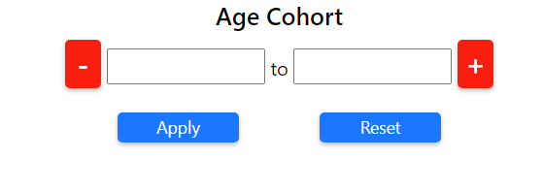
Notations used in ERONET 2.0
Selection of State, District, Assembly Constituency and Part
Used for expand the result set
To Download the report
A+ -> Maximise, A- -> Minimise, A ->Actual Size
To apply filter criteria + -> Add new range -> Delete range To apply filter criteria To apply filter criteria
Apply
Reset

Slide 8
Abbreviation used in ERONET 2.0 | Full Description
ECI | Election Commission of India
CEO | Chief Electoral Officer
DEO | District Election Officer
ERO | Electoral Registration Officer
AERO | Assistant Electoral Registration Officer
BLO | Booth Level Officer
OPR | Data Entry Operator
PC | Parliamentary Constituency
AC | Assembly Constituency
EPIC | Elector’s Photo Identity Card
DoP | Department of Posts
DSE | Demographical Similar Entry
PSE | Photo Similar Entry
TG | Third Gender
AMF | Assured Minimum Facility
EMF | Extended Minimum Facility

Slide 9
Introduction to ERONET
“ERONET is a web based network of Electoral Roll Officers of India. It provides the right amount of electoral information to the right set of people at the right time, for effective management and timely Voter Services”
ERONET is a web-based system for Electoral officials, in 14 languages and 11 scripts, to handle all processes pertaining to Form 6/6A/6B/7/8/.
1) All 29 States and 7 UTs are sharing common infrastructure at National Level.
2) UNPER (Unified National Photo Electoral Roll) is a common database for all States and UTs with data of more than 93 crore electors.
Contd…

Slide 10
Introduction to ERONET – contd.
ERONET standardised forms processing, standard database schema, and a standard template for EROLL printing.
It automates the process of Electoral Roll management starting from elector registration, field verification of electors, decision support system for Electoral registration officers(ERO) and for providing extensive integrated value-added services.
Citizens can fill up various online forms on Voters’ Service Portal (https://voters.eci.gov.in) or by using voter helpline mobile application. The form is processed thereafter in ERONET. The applicant as well as the officials get periodical alerts and notifications on each activity performed at ERONET.
The ERONET has been designed and developed keeping in mind the need of Centralized form Processing and monitoring the work of all the Officials involved in Form Processing.

Slide 11
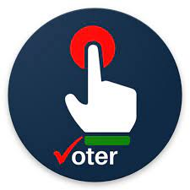
Flowchart for ERONET
Decision
ERONET
Accept
Form6A
Voters Service Portal
Form6B
Reject
Online
Form6
Voter Helpline App
Schedule Hearing
ERO
Validation
Applicants
Form8
Form7
Offline
Re-Initiate to AERO/BLO
AERO
BLO App
Forwards
Forward to other ERO
Submit
BLO
Part Assignment
Forward to DEO
Submit
ERONET
Forward
DEO
CEO
Operator
Checklist
AERO
BLO
AERO
Checks the form
Checks the Field Verification Report
ERO
Checks Supporting Documents
Enters his remarks
Checks for Logical Errors and DSE

Slide 12
Key Features of ERONET 2.0
The end goal is to achieve an order of magnitude increase in the functionality and utility over the existing ERONET, ensuring a “Single Source of Truth” for all relevant data, delivered through a Single App and Single Portal for all the stakeholders involved (i.e. Citizens, Election Officials, Political Parties & Candidates) with regard to all the processes related to maintenance and update of Electoral Roll.
A Vibrant User Dashboard and in-depth analytics
Alerts, Flags, Auto-generated messages, Emails, Notifications, etc
Customized Filter,
Infographics Dashboard
Use of new technology
Enhancement in transparency and accountability of the electoral officials by providing role-based access, audit trails and decision support system
Automatic Serialization of Elector data
Tools for Rationalization
Control Table Management
EROLL updation on single click
Group wise validation of Forms

Slide 13
Role Based Access Control
ECI Level
ECI Admin
Zonal Secy
State
CEO
CEO Admin
District
DEO
Dy DEO
AC
ERO
Data Entry Operator
Part
AERO (Part Assigned)
BLO (BLO APP)
Administrative Division
Roll Observer
Role based access defined in ERONET 2.0.
Following roles are defined :-

Slide 14
Part – B
User Management

Slide 15
User Creation Rules
User Id | Created By | Approved By
BLO, Data Entry Operator, AERO | ERO | DEO
ERO, Deputy DEO | DEO | CEO
DEO, Roll Observer | CEO | No Approval
CEO, CEO Admin, ECI Level, Commision | ECI Admin | No Approval

Slide 16
Business rule for edit profile
Request created by | Approved By
BLO, Data Entry Operator, AERO | ERO
ERO, Deputy DEO | DEO
DEO, Roll Observer | CEO
CEO, CEO Admin, ECI Level, Commision | ECI Admin

Slide 17
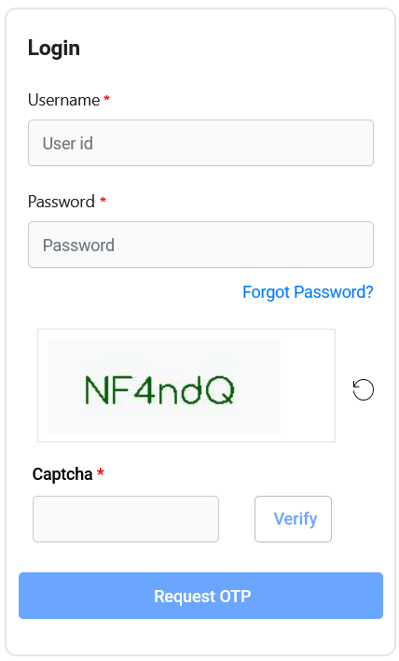
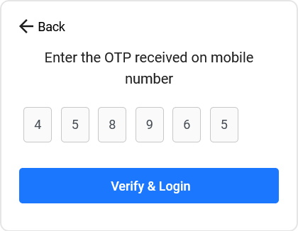
User must enter system generated Username and password for login. After verification of captcha user have to click on request OTP for OTP generation. OTP is received on phone.
Login Process
User will be re-directed to OTP page, here OTP received on phone has to be entered.
Double authentication mechanism used for login in ERONET 2.0.
The Login Process includes the user to login using his user ID and Password as well as OTP. Every time the user logs into the system he must verify the OTP.
For Edit Profile, the user will be making changes in the profile and a request will be sent for approval.
The Password expired after every 90 days for all accounts.
After 10 invalid Attempts users are locked for 1 Hour. After 1 hour account is auto unlocked.
After first time login user is re-directed to change password as well for future use. Once done, user can re-login to system using newly created password.

Slide 18
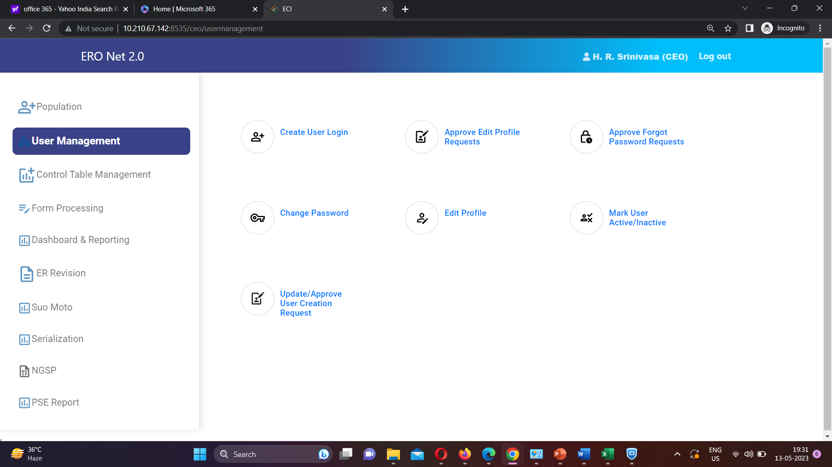
User Creation
After logging into the system user has to select User Management module to view main menu
User having user creation right have seven options, while other user have only two options (Change Password & Edit Profile).
Contd…

Slide 19
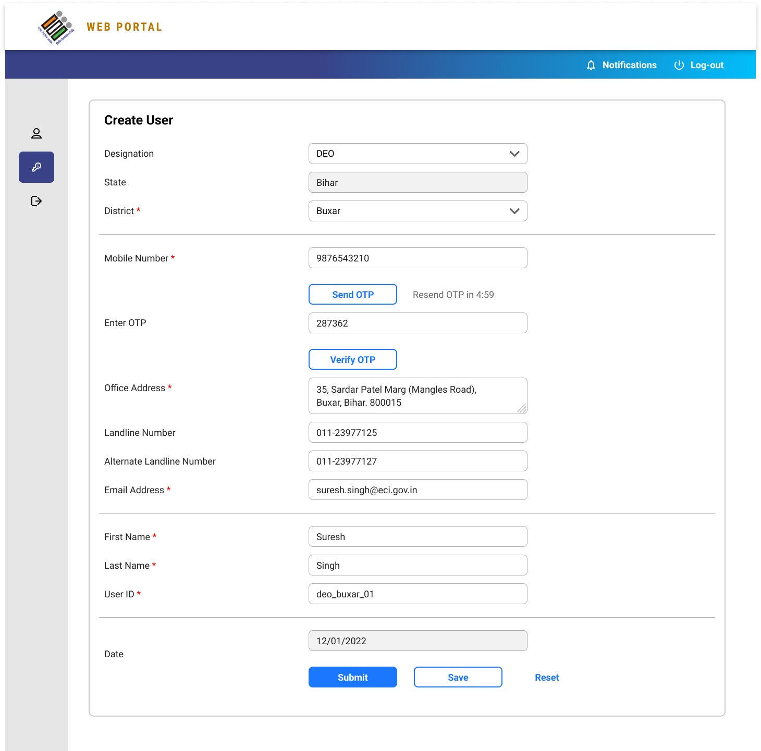
User Creation – contd.
For create a new user account user have to click on option.
System generated user name and password will be created after clicking on .
Mobile number verification is required at time of user creation.
Created user can login after approval and changing password.
Create User
Submit

Slide 20
Other Facilities in User Management
Approve Edit Profile Requests
After approval changes take places
Approve Forgot Password
For approval of forgot password request
After approval user can login with new password.
For approval of profile change request
Change Password
User can change their password.
Edit Profile
User can edit their profile and request sent for approval.
Mark user active inactive
Down the line user can be marked active or inactive
Approve user creation
Approval of user creation

Slide 21
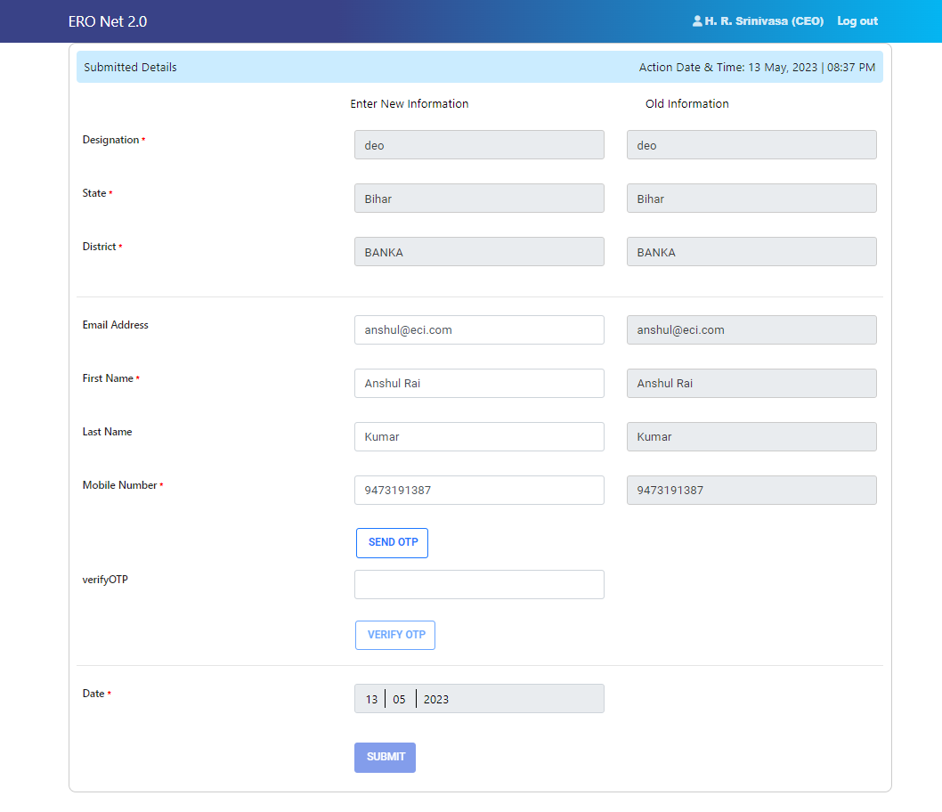
Update Profile
By clicking on 'Update profile' button, senior will be able to edit profile of his/her immediate juniors like DEO can edit profile of ERO.
By clicking on 'Update profile' button, user will be able to select from dropdown that for whom request needs to be edited. Dropdown will only have name of people for whom request can be edited. And finally, by clicking on submit button user will be able to edit profile as shown below.

Slide 22
Password Policy
System has taken care of below mentioned rules when password is changed/reset :
Password must be at least eight characters long
Password must have at least one digit (‘0’ to ‘9’).
Password must have at least one special character.
Password must have at least one uppercase (‘A’ to ‘Z’)
Passwords to be restricted to using only the lower 7-bit (specifically, 32-128) of the ASCII character set, covering the standard English alphabet (upper & lower case) along with the special characters on the keyboard (such as !,@,],}, ~, etc
User can only enter valid 10 digit mobile number.

Slide 23
Mode of Form Submission
Online
VSP (Voter Service Portal)
VHA (Voter Helpline App)
Offline
Hard copy received at BLO/AERO/ERO/DEO/CEO Level
BLO APP

Slide 24
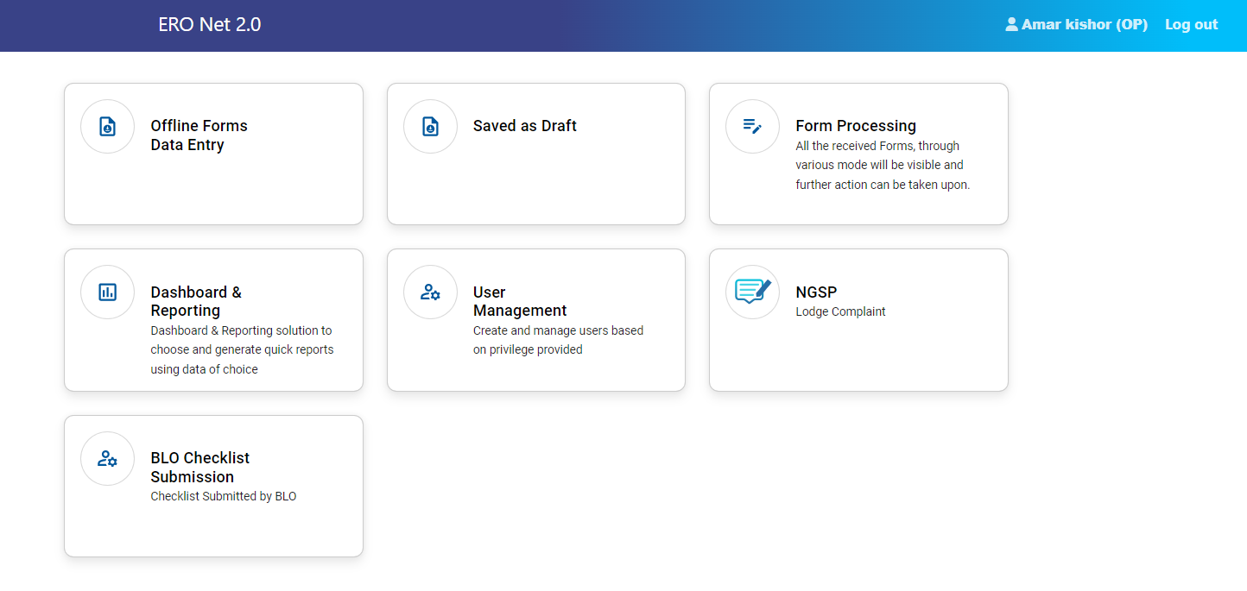
OPERATOR LOGIN
Offline Forms Entry
Saved as Draft
Form Processing
List of forms available for final submission which are save as draft
Digitisation of offline forms
Reporting and Dashboard
User Management
BLO checklist submission
NGSP
Digitisation of field verification report
Tracking of Forms
Change Password
Edit Profile
Tracking of forms which field verification reports are submitted either through BLO APP or operator login
Complaint registration and tracking of complaint status
Contd…

Slide 25
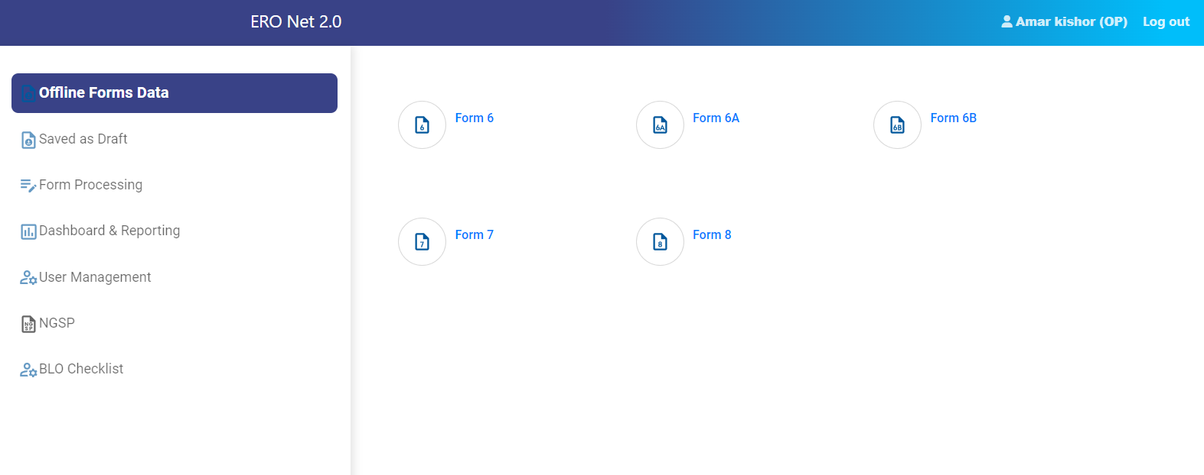
OPERATOR LOGIN – contd.
When operator clicks on 'Offline Forms Data Entry', user is able to see Forms menu, operator can click on form to fill.

Slide 26
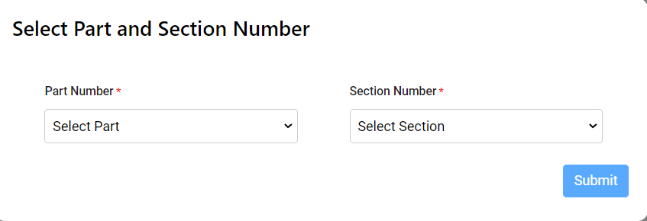
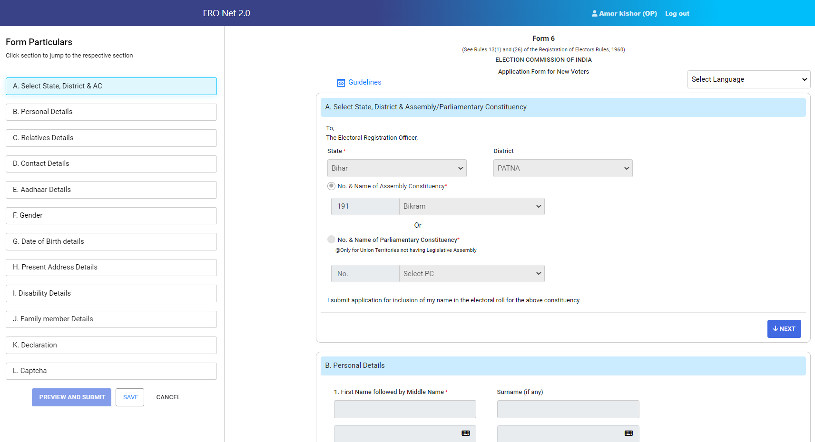
OPERATOR LOGIN – contd.
When operator clicks on 'Offline Forms Data Entry', user is able to see Forms menu, operator can click on form to fill.
For easy submission of form, Legal form are divided in multiple section like select district & AC, Personal Details, Relation Details , Contact Details…… etc.
Next button will enable after entry of all required field. Input filed are validated after clicking of Next button.
User have option to save the form as draft.
Option for preview.
Acknowledgement number generate on submission of forms.
Option to download ack. No. in the legal format of form.
Contd…

Slide 27
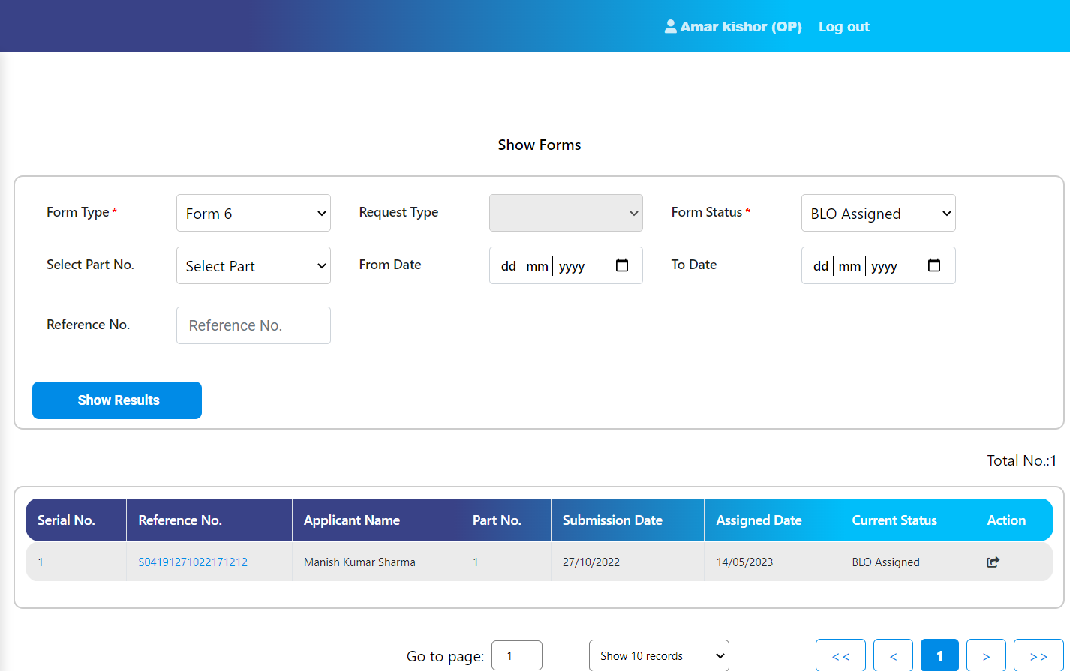
OPERATOR LOGIN – contd.
For digitization of Field Verification report operator have to click “Enter Field Verification Report” tab of Form Processing menu.
For submission to checklist operator have to click action button.
Operator can download the checklist.
Operator can edit the application if BLO edited the applicant details in checklist.
Contd…

Slide 28
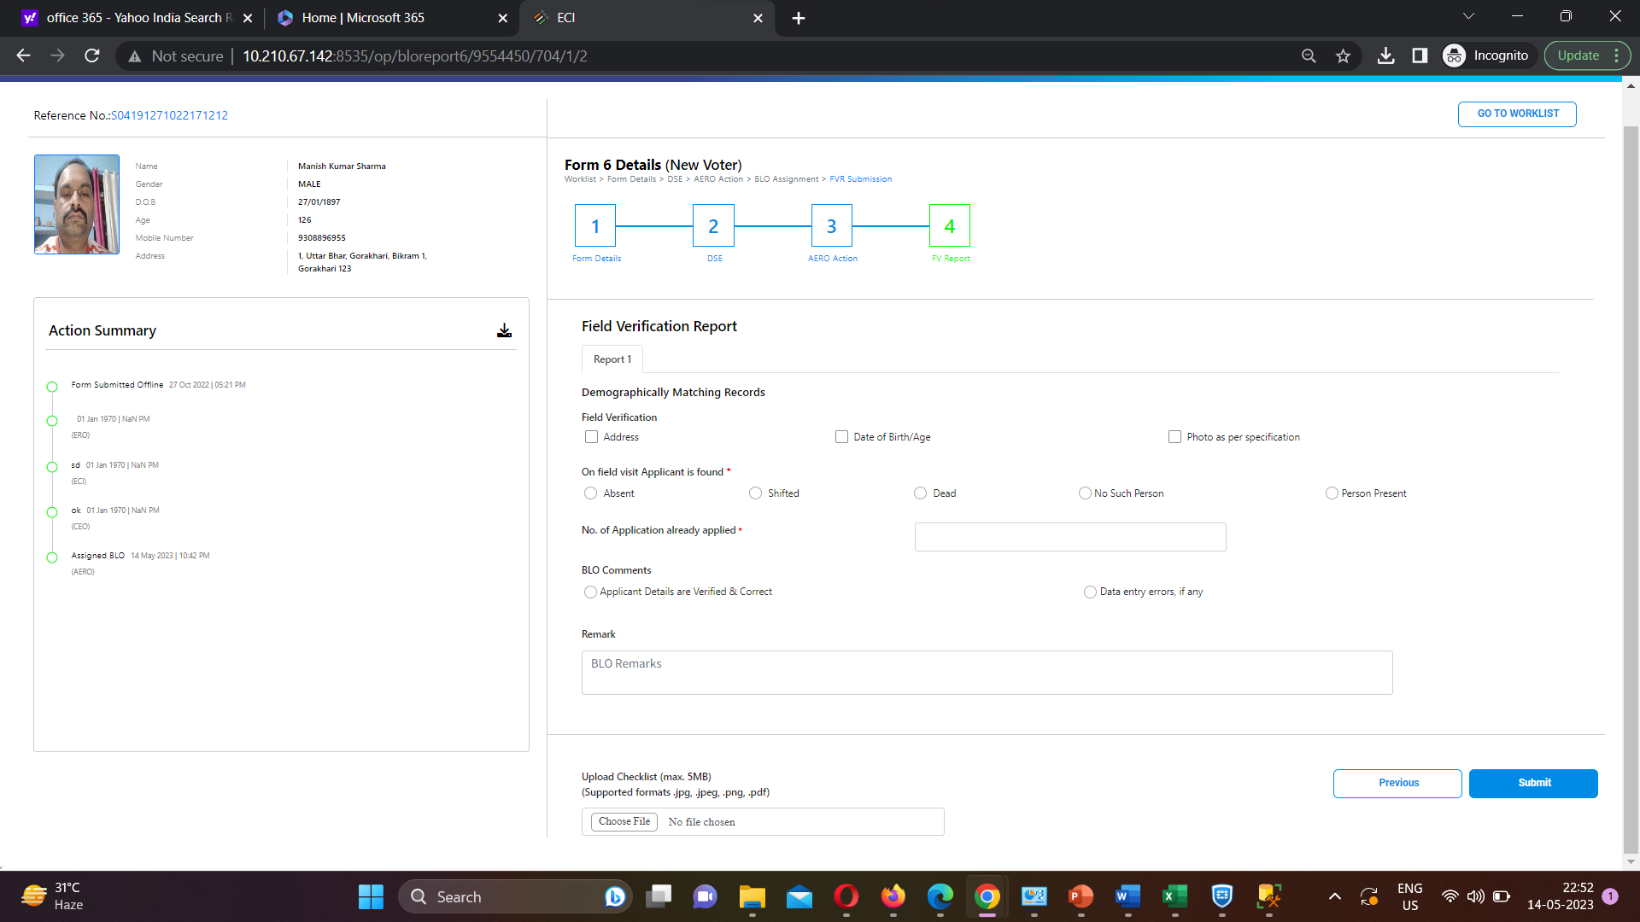
OPERATOR LOGIN – contd.
Checklist will be submitted after entry of checklist and uploading the signed copy of checklist .
Contd…

Slide 29
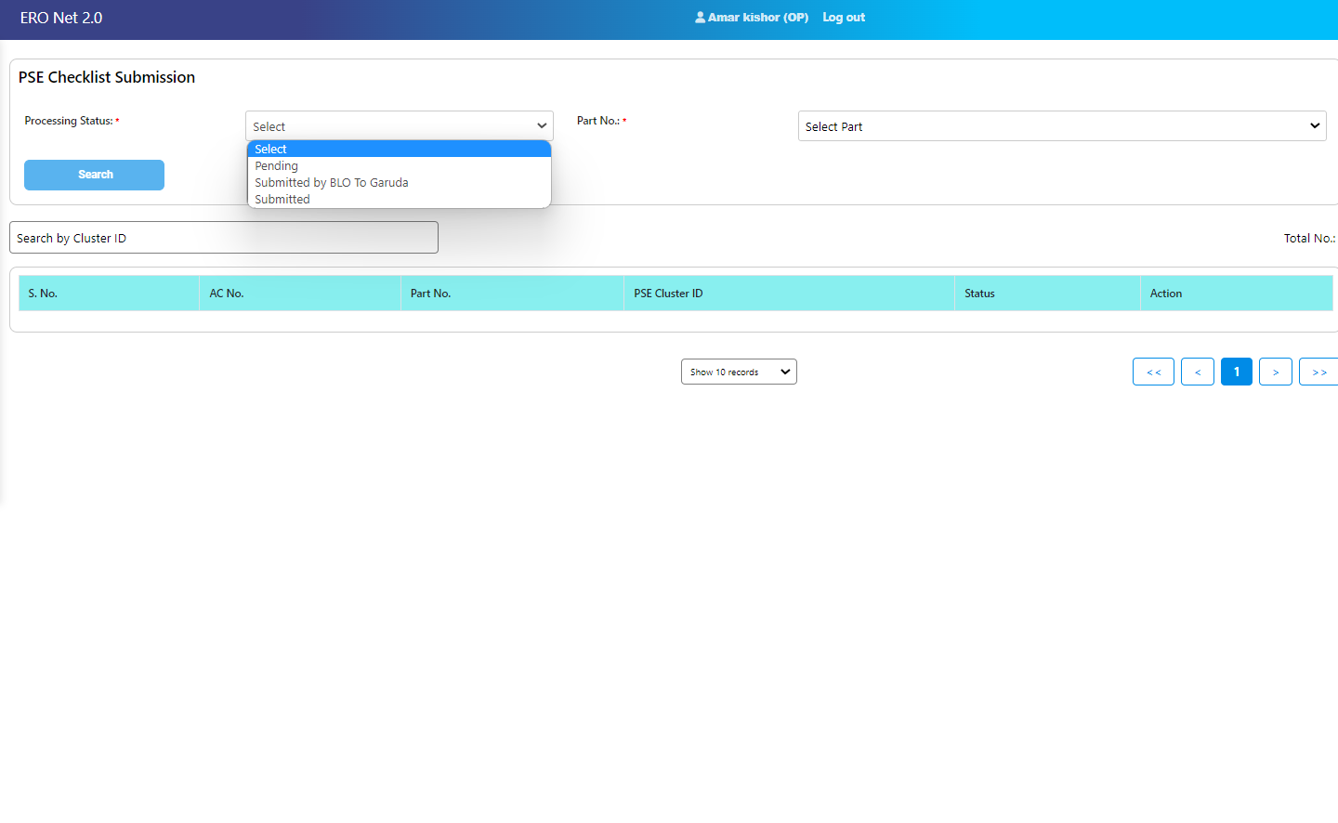
OPERATOR LOGIN – contd.
BLO Checklist of PSE
In this page operator can fill the checklist of identified PSE.
Operator can view the list of such PSE cluster in which checklist submitted through BLO APP

Slide 30
AERO LOGIN
AERO have privilege of three menu.
Part Assignment
Forward to ERO
Form Tracking
Contd…

Slide 31
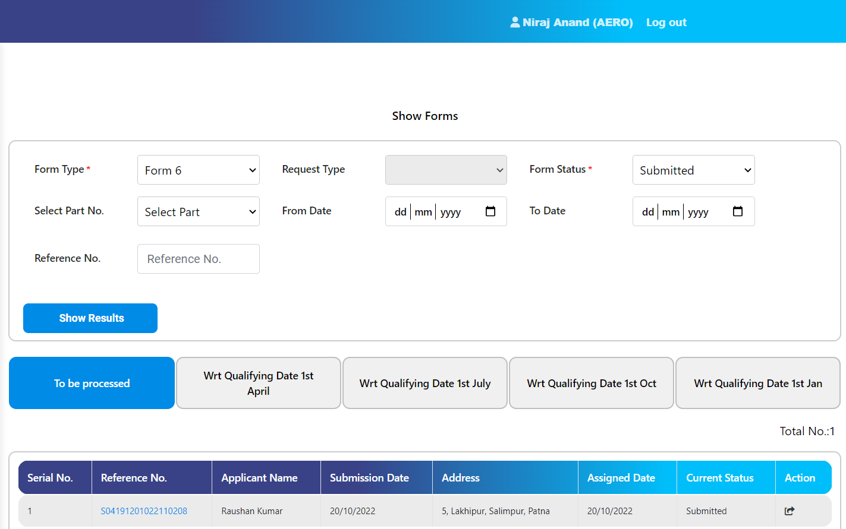
AERO LOGIN – contd.
Four buckets of Forms.
For part assignment click on action button.
On basis of applicant address part and section to be allotted.
Contd…

Slide 32
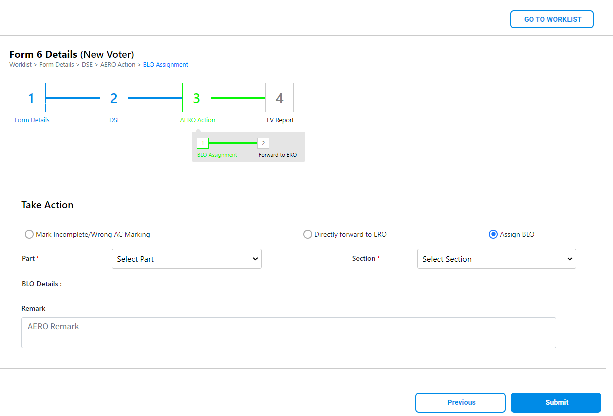
AERO LOGIN – contd.
AERO three option to perform on application.
Suggestive part & section appears.
Contd…

Slide 33
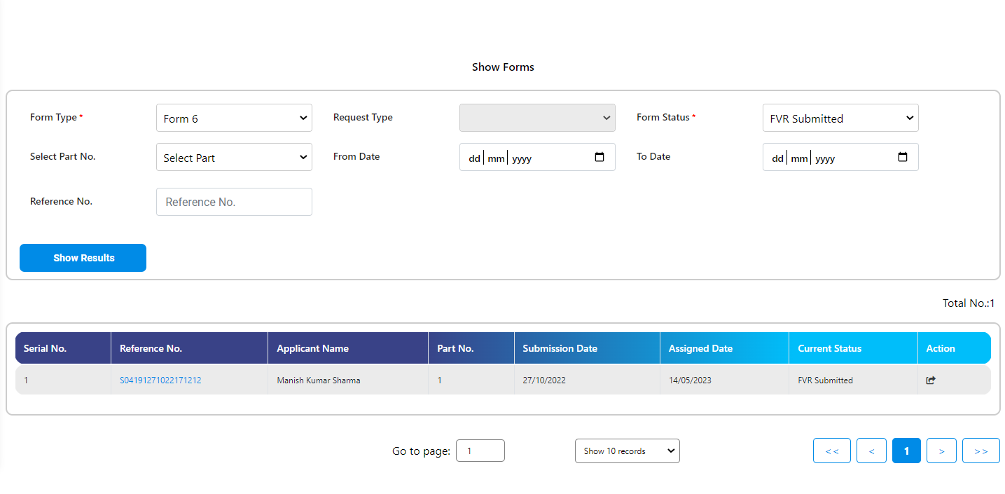
AERO LOGIN – contd.
Forward application to ERO for final decision.
Contd…

Slide 34
AERO LOGIN – contd.
Error rectification of forms which is rejected in EROLL updation process.

Slide 35
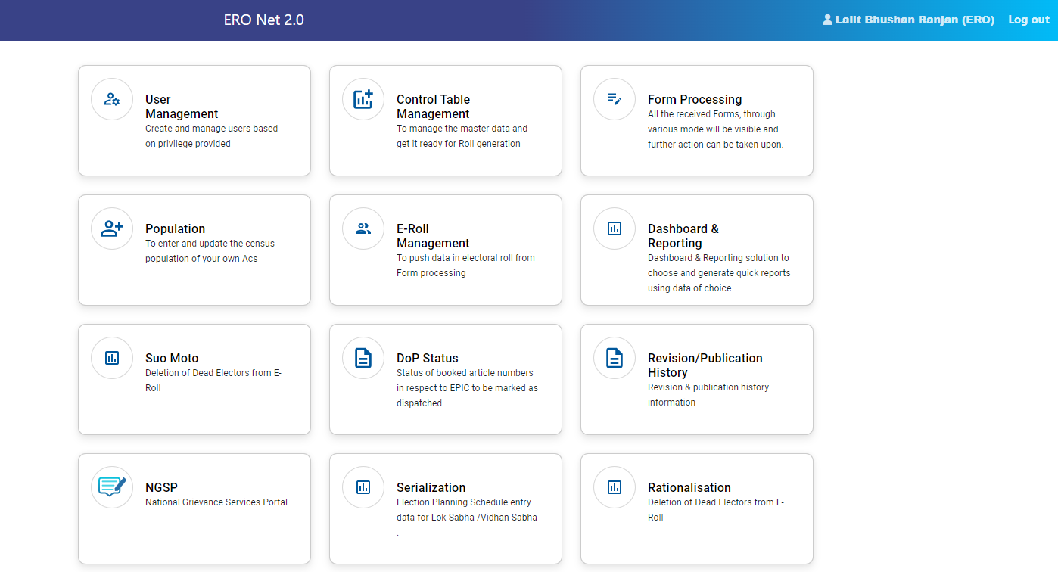
ERO LOGIN
ERO is one of the major user of ERONET.
ERO have vital role in serialization and rationalization process on ERONET 2.0.
Suo moto operation.
Contd…

Slide 36
ERO LOGIN – contd.
ERO functionality under User Management menu.
Contd…

Slide 37
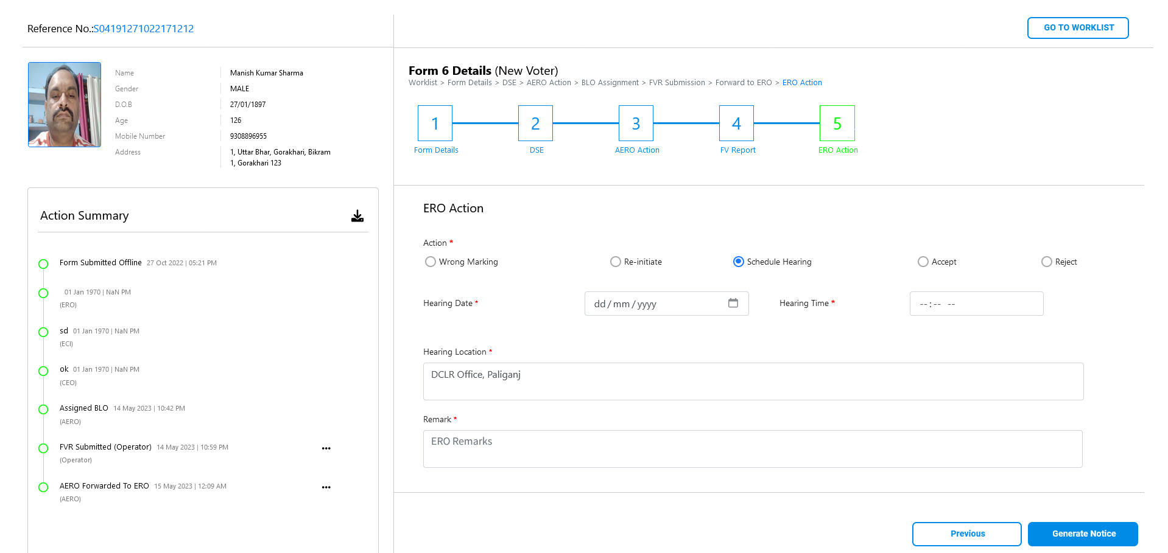
ERO LOGIN – contd.
ERO functionality under User Management menu.
Contd…

Slide 38
ERO LOGIN – contd.
In this page ERO have t download the statutory format of Form9, 10, 11, 11A, 11B AND Form 9 (Advance claim and objection).
Contd…

Slide 39
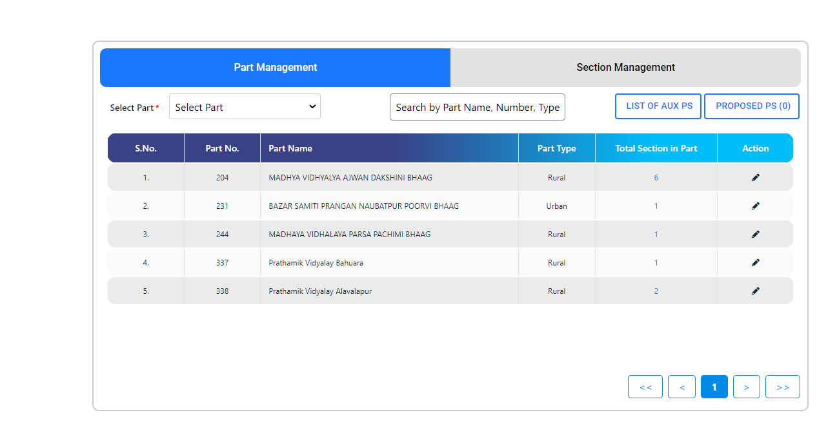
ERO LOGIN – contd.
ERO have facility to edit part name.
Creation of Aux Ps.
Section Management.
Contd…

Slide 40
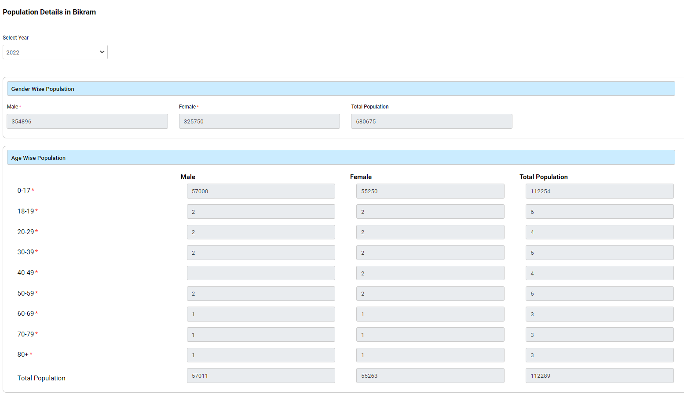
ERO LOGIN – contd.
View option of population entered by District level.
Contd…

Slide 41
ERO LOGIN – contd.
Accept forms are further updated in EROLL.
Inclusion – EPIC generation
Modification/Correction- Update in EROLL
Deletion – Delete from EROLL.
Contd…

Slide 42
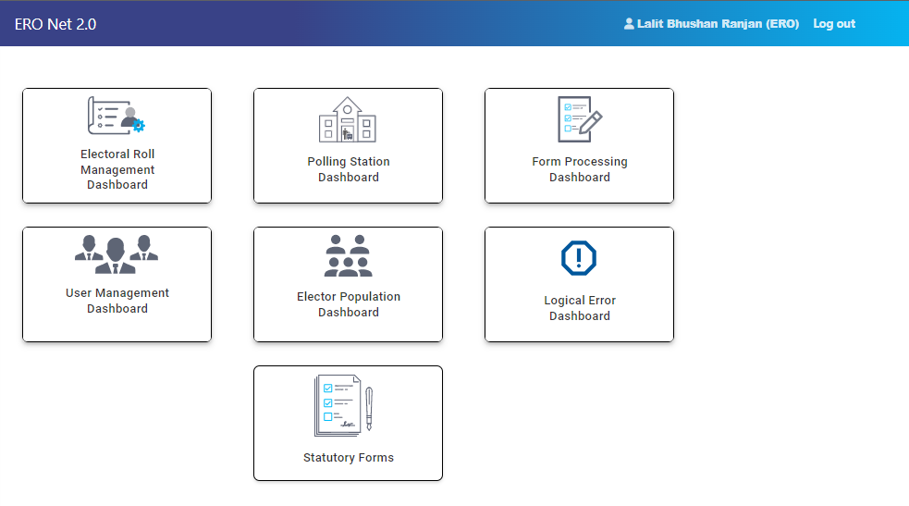
ERO LOGIN – contd.
Dashboard screen of ERO login
Contd…

Slide 43
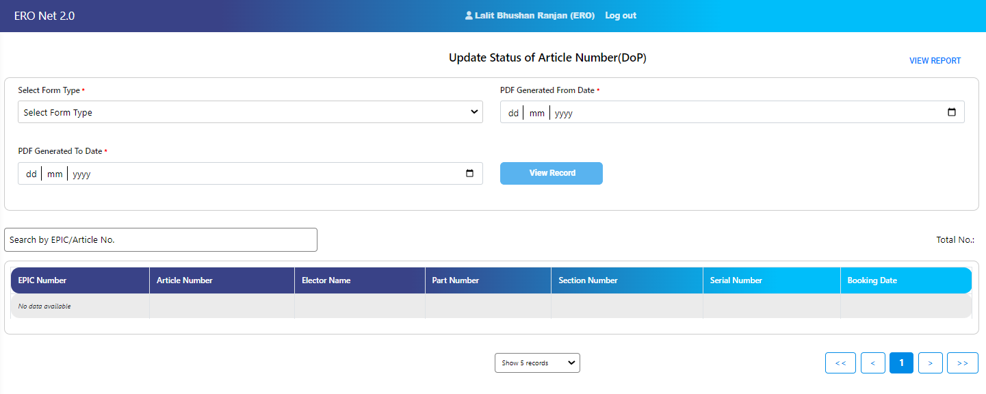
ERO LOGIN – contd.
Booking of EPIC Kit.
Report of DoP Processing Summary
View the list of article Booking
Contd…

Slide 44
ERO LOGIN – contd.
ERO can accept or reject the request of wheelchair received through SAKSHAM APP.

Slide 45
DEO LOGIN
Main menu of DEO account.
Contd…

Slide 46
DEO LOGIN – contd.
Accept/Reject rollback request.
Reassign the form to concern AC/District.
Tracking of form
Contd…

Slide 47
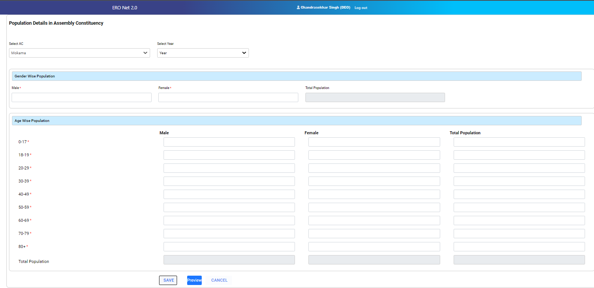
DEO LOGIN – contd.
DEO has facility to enter the gender wise and gender wise age cohort wise population of all AC of his/her jurisdiction.
Gender wise total population and age cohort wise total population .

Slide 48
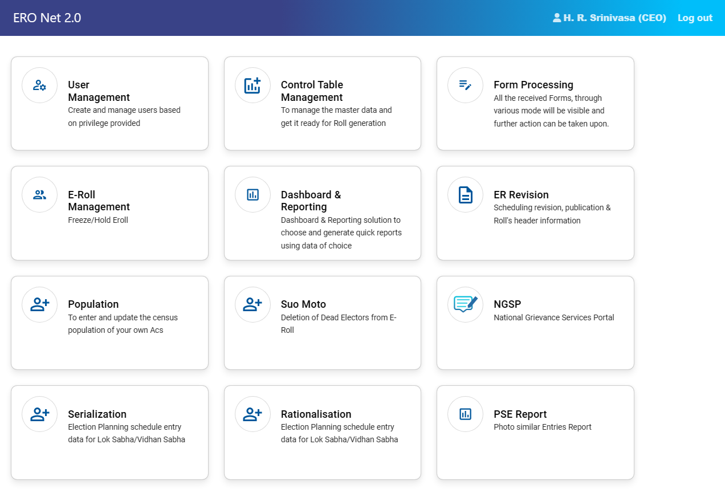
CEO LOGIN
CEO account is the state level master account.
CEO account have privilege to create district level account on ERONET.
Initiate serialization and rationalization.
Schedule revision.
Enable/disable Eroll update functionality.

Slide 49
CEO LOGIN – contd.
CEO Admin LOGIN
CEO admin have these options in ERONET 2.0

Slide 50
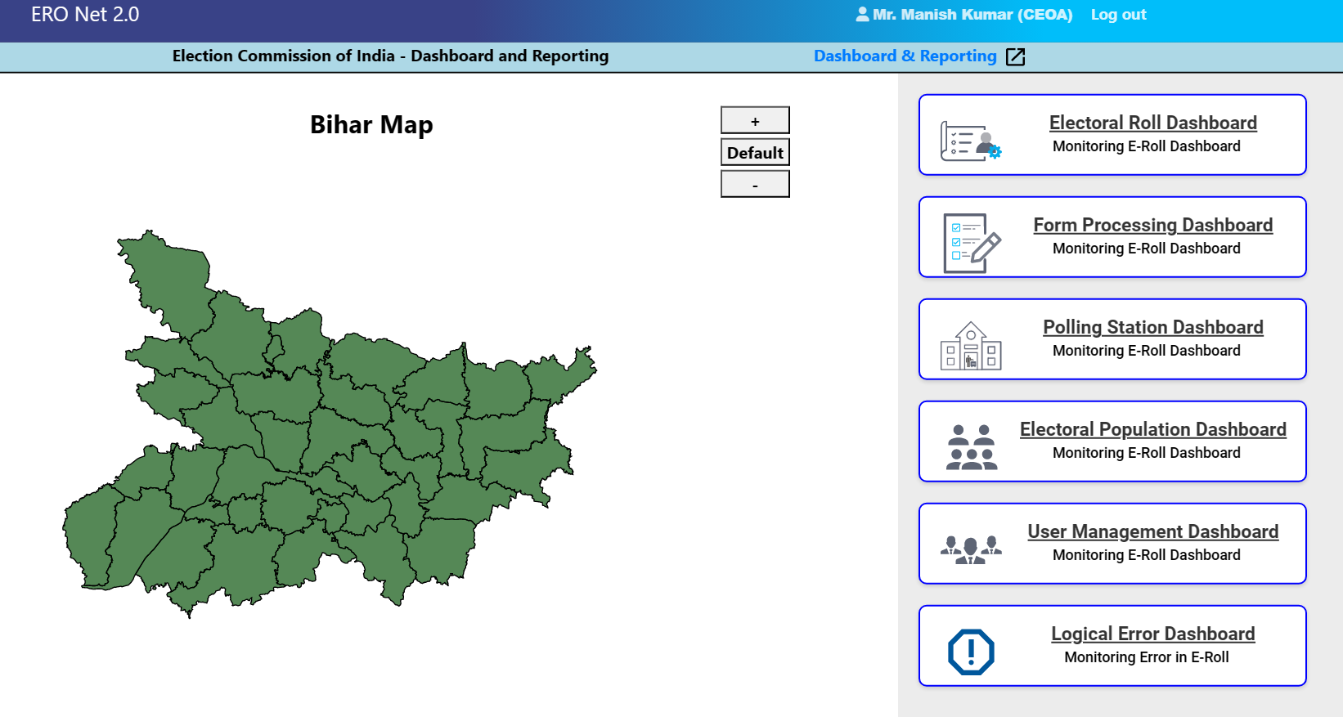
Dashboard & Reporting
Same dashboard functionality is available for all user.
All user can access the data of his/her jurisdiction only.

Slide 51
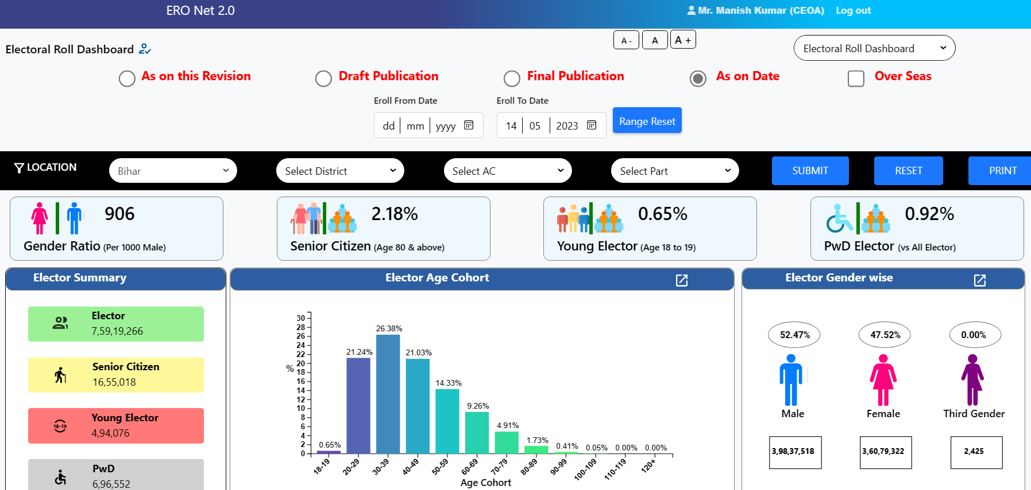
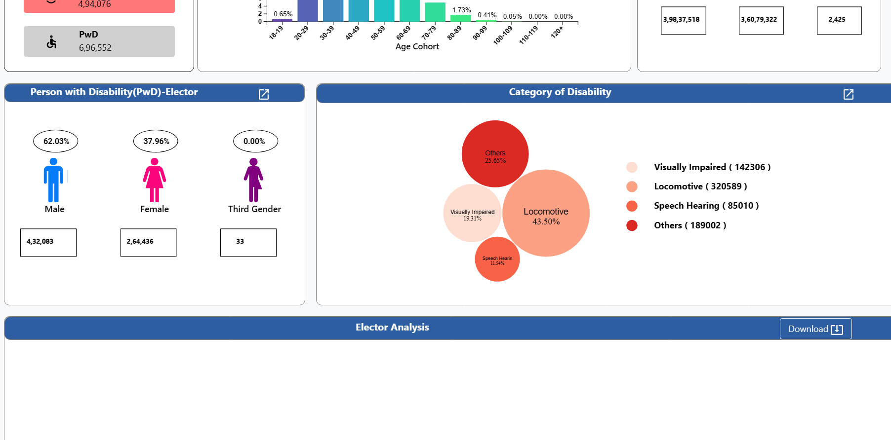
Dashboard & Reporting
Form Processing
On Elector Roll dashboard gender wise, Age cohort wise, PWD count
Gender ratio, Senior Citizen
Partwise filter for all reports

Slide 52
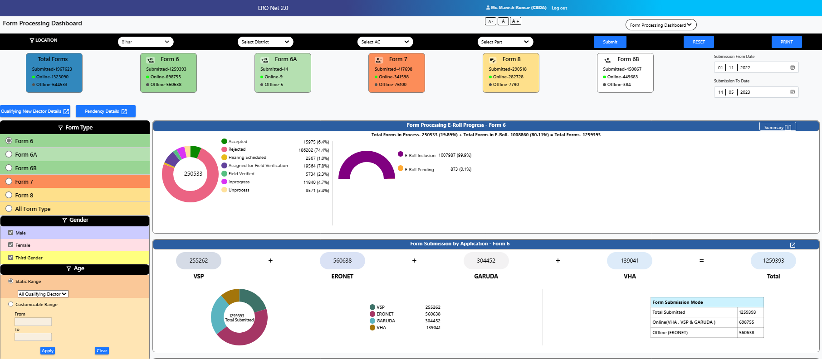
Dashboard & Reporting
Form Processing
On Form processing dashboard form wise, status wise, submission channel wise and status wise details.

Slide 53
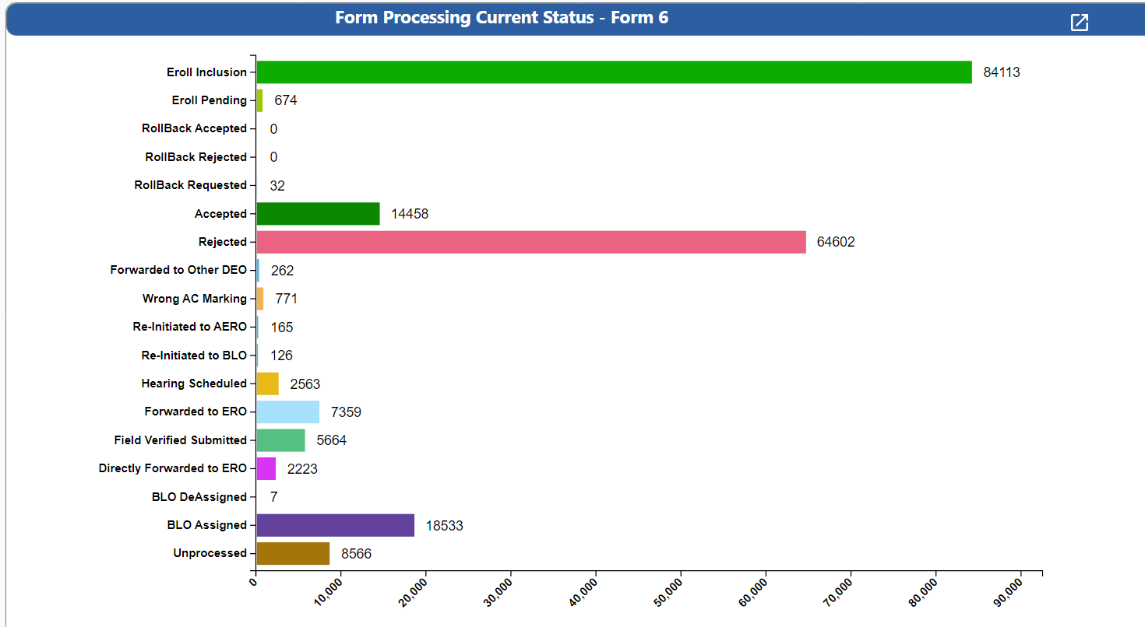
Form Processing
Dashboard & Reporting

Slide 54
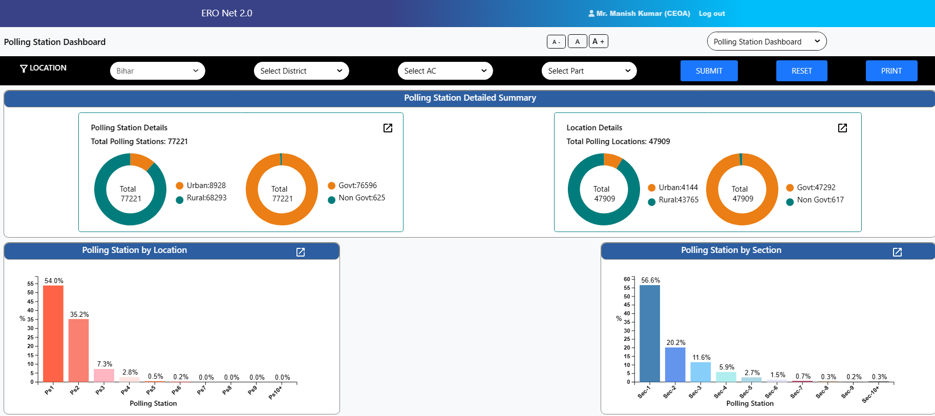
Dashboard & Reporting
Polling Station
On Polling Station dashboard rural/urban PS details.
Polling station wise elector count
AMF/EMF/Improved Maps details

Slide 55
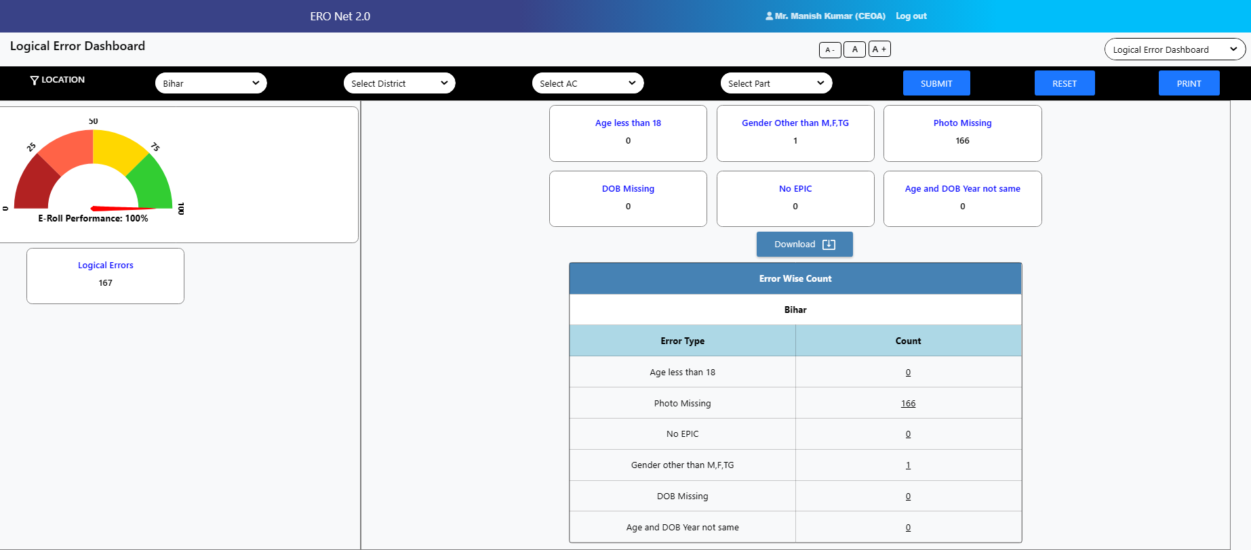
Dashboard & Reporting
Logical Error
State/District/AC/Part wise logical error count are displayed on the LE dashboard.

Slide 56
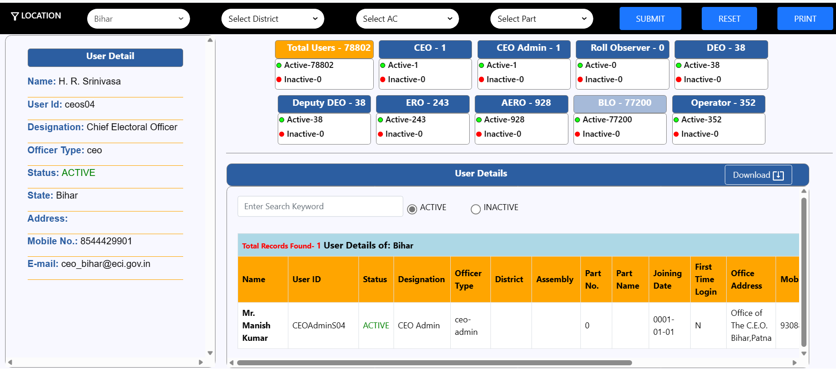
Dashboard & Reporting
User Management
Role wise active and inactive user details available.
List of all user can also be downloaded.

Slide 57
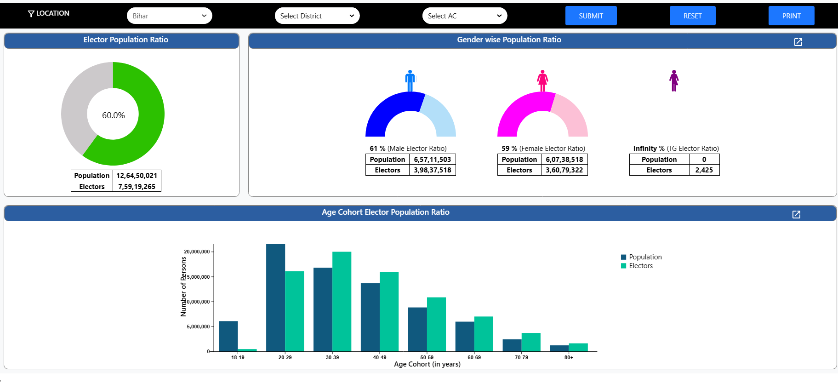
Dashboard & Reporting
Population Dashboard
State, District and AC wise gender wise population data with graphical presentation

Slide 58
Supporting APP/Portal to ERONET
VSP- Voter Service Portal
Form Submission
Elector search
E-EPIC download
Application Status tracking
Voter Helpline
Form Submission
Elector search
Complain Registration
Affidavit of Candidate
BLO APP
Polling Station GIS mapping
AMF/EMF updation
H2H verification
Checklist Verification
ER Printing Tool
Electoral Roll Generation
EPIC Generation
Supplement Generation
Voter Slip & Alphabetical Roll Generation

Slide 59
Case Study
How ERO find the list of BLO who have not submitted any form in the given period?
How ERO find the number of polling station having elector more than 1500?
How can ERO find the list of less women enrollment?

